Slide 1
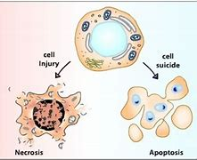
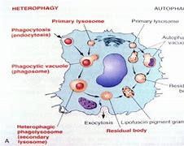
Cellular Reactions To Injury
Diyah Candra Anita

Slide 2
Learning objectives
The student should be able to:
Define hyperplasia, hypertrophy, atrophy, & Metaplasia & list some of their causes.
Know the differences between reversible & irreversible forms of cell injury.
Describe the mechanisms of necrosis.
Describe the various types of necrosis & know some of their causes.

Slide 3
Introduction
Cell injury underlies all diseases.
When a cell is exposed to an injurious agent, the possible outcomes are:
The cell may adapt to the situation or
They cell may acquire a reversible injury or
The cell may obtain an irreversible injury & may die. The cell may die via one of two ways: either by necrosis or by apoptosis.
These outcomes occur depends on both the injurious agent & on cellular factors.
In other words, the result depends on the type, severity, duration of the injury & on the type of the cell.

Slide 4
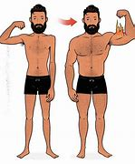
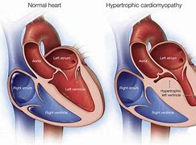
Types of cellular adaptation (1)
Hypertrophy
Hypertrophy is increase in the size of cells. Increased workload leads to increased protein synthesis & increased size & number of intracellular organelles which, in turn, leads to increased cell size
The increased cell size leads to increased size of the organ.
Examples: the enlargement of the left ventricle in hypertensive heart disease & the increase in skeletal muscle during sternous exercise

Slide 5
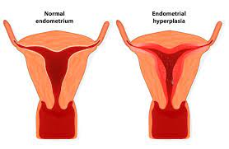
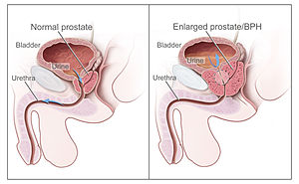
Types of cellular adaptation (2)
Hyperplasia
Hyperplasia is an increase in the number of cells. It can lead to an increase in the size of the organ.
It is usually caused by hormonal stimulation.
It can be physiological as in enlargement of the breast during pregnancy or it can pathological as in endometrial hyperplasia

Slide 6
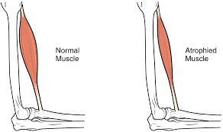
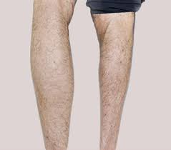
Types of cellular adaptation (3)
Atrophy
Atrophy is a decrease in the size of a cell.
The atrophic cell shows autophagic vacuoles which contain cellular debris from degraded organelles.
This can lead to decreased size of the organ.
Atrophy can be caused by:
Disuse
Undernutrition
Decreased endocrine stimulation
Denervation
Old age

Slide 7
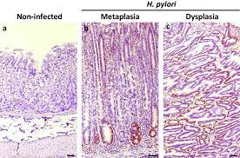
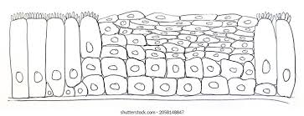
Types of cellular adaptation (4)
Metaplasia
Metaplasia is the replacement of one differentiated tissue by another differentiated tissue.
Squamous metaplasia
This is replacement of another type of epithelium by squamous epithelium.
Osseous metaplasia
This replacement of a connective tissue by bone
There are different types of metaplasia.
Examples include:
For example, the columnar epithelium of the bronchus can be replaced by squamous epithelium in cigarette smokers
For example at sites of injury

Slide 8
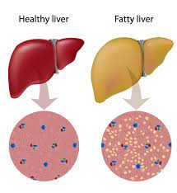
Reversible cellular changes & accumulations (1)
Fatty change
This is accumulation of triglycerides inside parenchymal cells.
It is caused by an imbalance between the uptake, utilization, & secretion of fat.
Fatty change is usually seen in the liver, heart, or kidney.
Fatty liver may be caused by alcohol, diabetes mellitus, malnutrition, obesity, & poisonings.
These etiologies cause accumulation of fat in the hepatocytes by the following mechanisms
Increased uptake of triglycerides into the parenchymal cells.
Decreased use of fat by cells.
Overproduction of fat in cells.
Decreased secretion of fat from the cells.

Slide 9
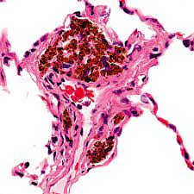
Reversible cellular changes & accumulations (2)
The accumulations of pigments
Pigments can be exogenous or endogenous.
Endogenous pigments include melanin, bilirubin, hemosiderin, & lipofuscin.
Exogenous pigments include carbon. These pigments can accumulate inside cells in different situations

Slide 10
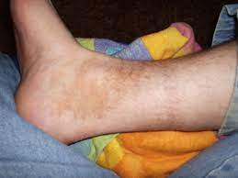
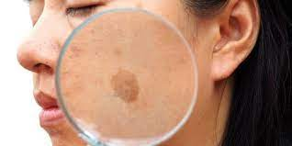
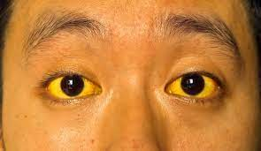
Melanin
Bilirubin
Hemosiderin
Melanin is a brownish-black pigment produced by the melanocytes found in the skin.
Increased melanin pigmentation is caused by suntanning & certain diseases e.g. nevus, or malignant melanoma.
Decreased melanin pigmentation is seen in albinism & vitiligo.
Bilirubin is a yellowish pigment, mainly produced during the degradation of hemoglobin.
Excess accumulation of bilirubin causes yellowish discoloration of the sclerae, mucosae, & internal organs → Such a yellowish discoloration is called jaundice.
Hemosiderin is an iron-containing pigment derived from ferritin.
It appears in tissues as golden brown amorphous aggregates.
Hemosiderin exists normally in small amounts within tissue macrophages of the bone marrow, liver, & spleen as physiologic iron stores.
It accumulates in tissues in excess amounts in certain diseases.

Slide 11
Cell death
Cells can die via one of the following two ways:
Necrosis
Apoptosis

Slide 12
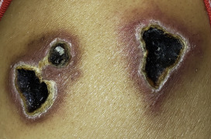
Necrosis
In necrosis, excess fluid enters the cell, swells it, & ruptures its membrane which kills it.
After the cell has died, intracellular degradative reactions occur within a living organism.
Necrosis does not occur in dead organisms. In dead organisms, autolysis & heterolysis take place.
Necrosis occurs by the following mechanisms:
Hypoxia
Free radical-induced cell injury
Cell membrane damage
Increased intracellular calcium level

Slide 13
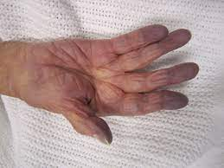
Hypoxia
Hypoxia is decreased oxygen supply to tissues. It can be caused by:
Ischemia
Ischemia is decreased blood flow to or from an organ.
Anemia
Anemia is a reduction in the number of oxygen-carrying red blood cells.
Carbon monoxide poisoning
CO decreases the oxygen-capacity of red blood cells by chemical alteration of hemoglobin.
Poor oxygenation of blood due to pulmonary disease.
Ischemia can be caused by obstruction of arterial blood flow – the most common cause, or by decreased perfusion of tissues by oxygen-carrying blood as occurs in cardiac failure, hypotension, & shock.

Slide 14
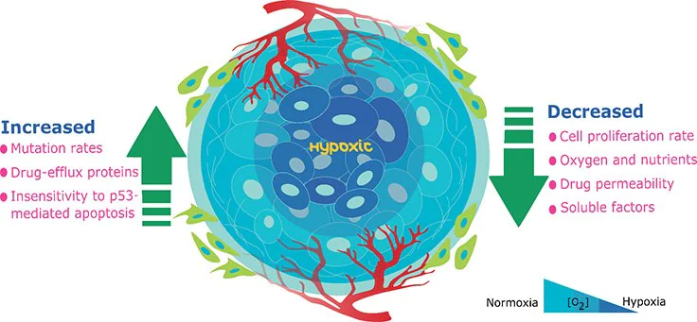

Slide 15
Hypoxia can be divided into early & late stages
Early (reversible) stages of hypoxic cell injury
Late (irreversible) stages of hypoxic cell injury.
At this stage, hypoxia results in decreased oxidative phosphorylation & ATP synthesis.
Failure of the cell membrane Na – K pump, which leads to increased intracellular Na & water, which cause cellular & organelle swelling → Cellular swelling
Disaggregation of ribosomes & failure of protein synthesis.
Decreased ATP leads to:
This is caused by severe or prolonged injury.
It is caused by massive calcium influx & very low pH, which lead to activation of enzymes, which damage the cell membrane& organelle membranes.
Irreversible damage to the cells → the cell is destined to die

Slide 16
Free radical-induced injury
Free radical is any molecule with a single unpaired electron in the outer orbital.
Examples include superoxide & the hydroxyl radicals.
Free radicals are formed by normal metabolism, oxygen toxicity, ionizing radiation, drugs & chemicals, & reperfusion injury.
They are degraded by spontaneous decay, intracellular enzymes such as glutathione peroxidase, catalase, or superoxide dismutase, & endogenous substances such as ceruloplasmin or transferrin.
When the production of free radicals exceeds their degradation, the excess free radicals cause membrane pump damage, ATP depletion, & DNA damage

Slide 18
Free radical injury, cont’
These can cause cell injury & cell death.
Cell membrane damage
Direct cell membrane damage as in extremes of temperature, toxins, or viruses, or indirect cell membrane damage as in the case of hypoxia can lead to cell death by disrupting the homeostasis of the cell.
Increased intracellular calcium level
Increased intracellular calcium level is a common pathway via which different causes of cell injury operate. For example, the cell membrane damage leads to increased intracellular calcium level.
The increased cytosolic calcium, in turn, activates enzymes in the presence of low pH. The activated enzymes will degrade the cellular organelles.

Slide 19
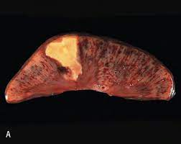
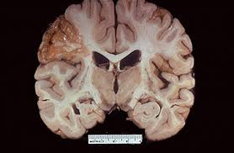
Types of necrosis (1)
Coagulative necrosis
Liquefactive necrosis
Cogulative necrosis most often results from sudden interruption of blood supply to an organ (ischemia or infarction), especially to the heart.
It is, in early stages, characterized by general preservation of tissue architecture.
It is marked by the following nuclear changes: Pyknosis (which is chromatin clumping & shrinking with increased basophilia), karyorrhexis (fragmentation of chromatin), & karyolysis (fading of the chromatin material).
Liquefactive necrosis is characterized by digestion of tissue (a type of necrosis which results in a transformation of the tissue into a liquid viscous mass)
It characteristically results from ischemic injury to the CNS.
It also occurs in suppurative infections (bacterial or fungal infections) characterized by formation of pus.
It shows softening & liquefaction of tissue.

Slide 20
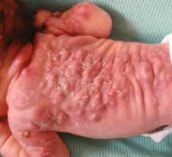
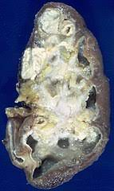
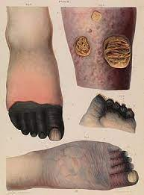
Types of necrosis (2)
Fat necrosis
Caseous necrosis
Fat necrosis can be caused by trauma to tissue with high fat content, such as the breast or it can also be caused by acute hemorrhagic pancreatitis in which pancreatic enzymes diffuse into the inflamed pancreatic tissue & digest it.
Caseous necrosis has a cheese-like (caseous, white) appearance to the naked eye.
It appears as an amorphous eosinophilic material on microscopic examination.
Caseous necrosis is typical of tuberculosis.
Gangrenous necrosis
This is due to vascular occlusion & most often affects the lower extremities & the bowel.
It is called wet gangrene if it is complicated by bacterial infection which leads to superimposed liquefactive necrosis.
Whereas it is called dry gangrene if there is only coagulative necrosis without liquefactive necrosis.

Slide 21
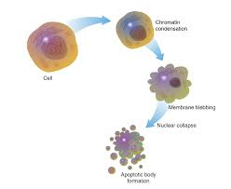
Apoptosis
Apoptosis is the death of single cells within clusters of other cells. (Note that necrosis causes the death of clusters of cells.)
In apoptosis, the cell shows shrinkage & increased acidophilic staining of the cell. This is followed by fragmentation of the cells. → These fragments are called apoptotic bodies.
Apoptosis usually occurs as a physiologic process for removal of cells during embryogenesis, menstruation, etc. → It can also be seen in pathological conditions caused by mild injurious agents.
Apoptosis is not followed by inflammation or calcification. The above mentioned features distinguish apoptosis from necrosis

Slide 22
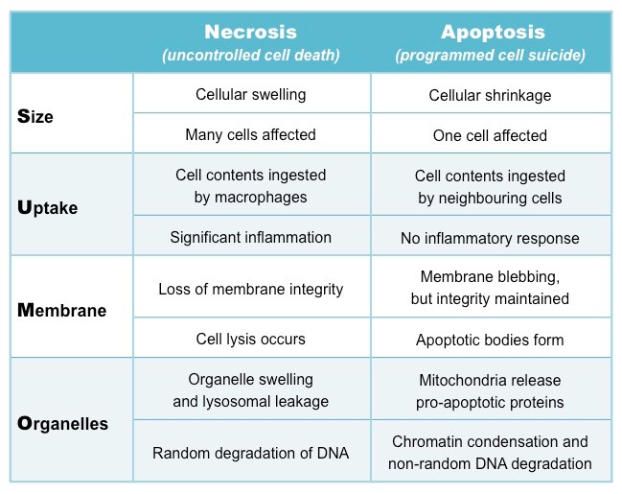
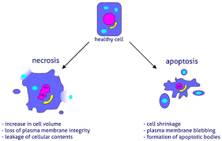

Slide 23
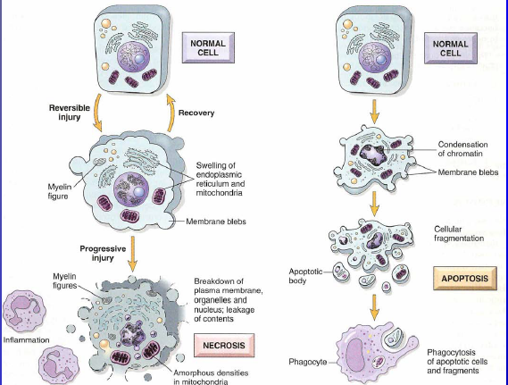

Slide 24
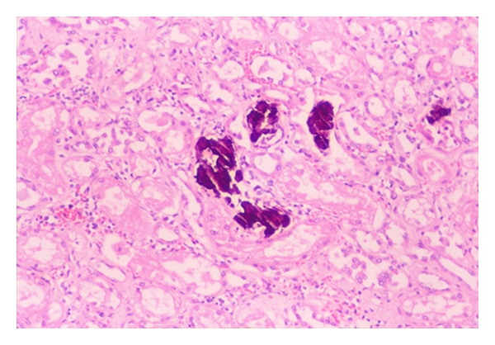
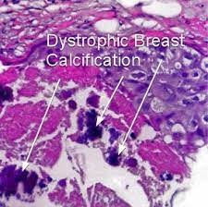
Pathologic calcification
Metastatic calcification
This is caused by hypercalcemia, resulting from hyperparathyroidism, milk-alkali syndrome, sarcoidosis etc
Dystrophic calcification
This occurs in previously damaged tissue, such as areas of old trauma, tuberculous lesions, scarred heart valves, & atherosclerotic lesions.
it is not caused by hypercalcemia

Slide 25
Thank you…

