Slide 1
THE HUMAN MOVEMENT SYSTEM

Slide 2
Learning Outcome
Mhs memahami dan mampu menjelaskan komponen sistem GERAK manusia.
Mhs mammu memahami anatomi system musculoskeletal
Mhs Memahami mampu menjelaskan fungsi sistem musculoskeletal

Slide 3
KOMPONEN GERAK MANUSIA
SISTEM MUSCULO SCELETAL
SYSTEM NEOROLOGI
SYSTEM CARDIORESPIRASI & VASCULER
SYSTEM ENDOKRINE

Slide 4
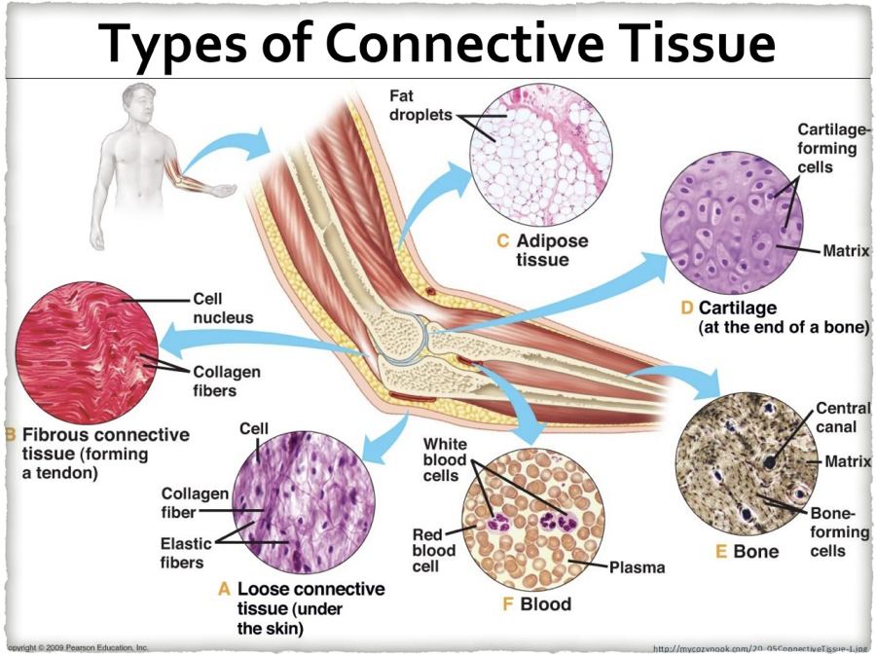
KOMPONEN GERAK

Slide 5
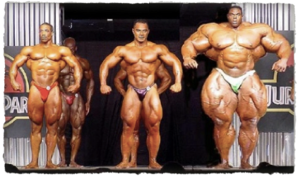
SISTEM MUSCULO SKELETAL
Sistem musculoskeletal adalah salad satu sistem yang menyusun bentuk tubuh kita yang meliputi perangkat keras yaitu tulang ( bone/skelet) dan perangkat lunak ( otot

Slide 6
FUNGSI SISTEM MUSCULOSKELETAL
MELINDUNGI ORGAN DARI ANCAMAN
MENJAGA BENTUK TUBUH (RANGKA)
MERUBAH ENERGI KIMIA MENJADI ENERGI KINETIK
MOBILTAS DAN FUNGSI TUBUH

Slide 7
INTRODUCTION : MUSCLE/MUSCULO/MYO
Muscle are impresive motors that respond rapidly to commands from motor nervous sistem
Sceletal muscle cells can increase their force production up to 40N/cm2 in less than 100 ms. When un loaded they can shorthen at rate of up to ten muscle lengths/s

Slide 8
JARINGAN OTOT
Adalah statu bundel yang tersusun oleh sel yang panjang
Mampu berkontraksi ( memanjang/mendek)
Fungsi utama untuk bergerak
Manusia mimiliki 600 otot
30-40% masa tubuh

Slide 9
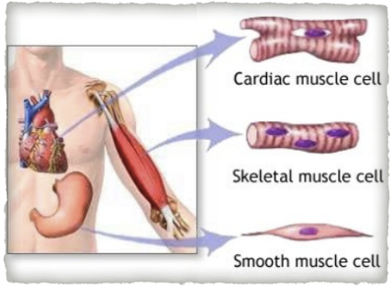
JENIS JENIS OTOT
OTOT LURIK/SKELETAL
OTOT POLOS/SMOOTH M
OTOT JANTUNG/CARDIAC

Slide 10
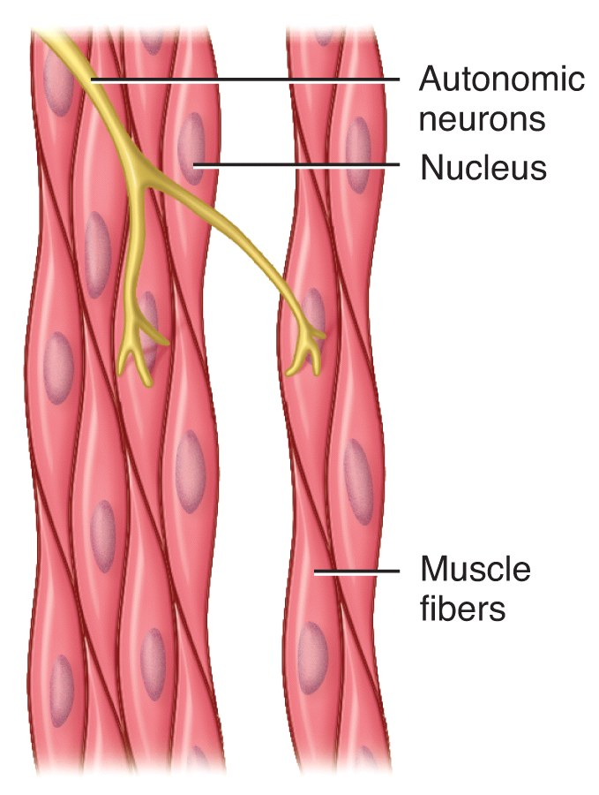
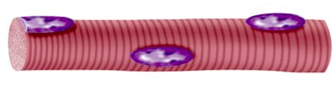
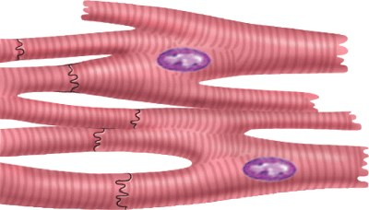
Three Types of Muscular Tissue
(a) Skeletal muscle
(b) Cardiac muscle
(c) Visceral smooth muscle

Slide 11
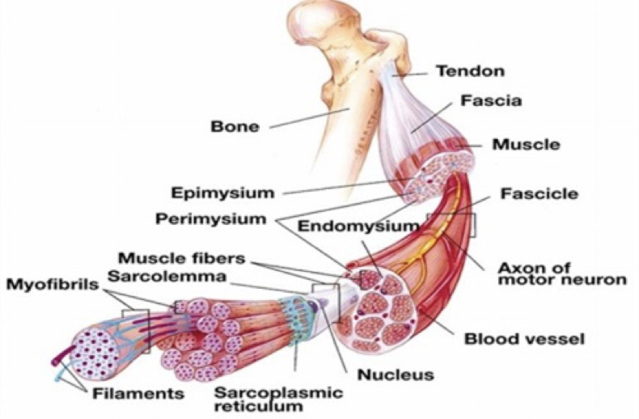
KOMPONEN OTOT

Slide 12
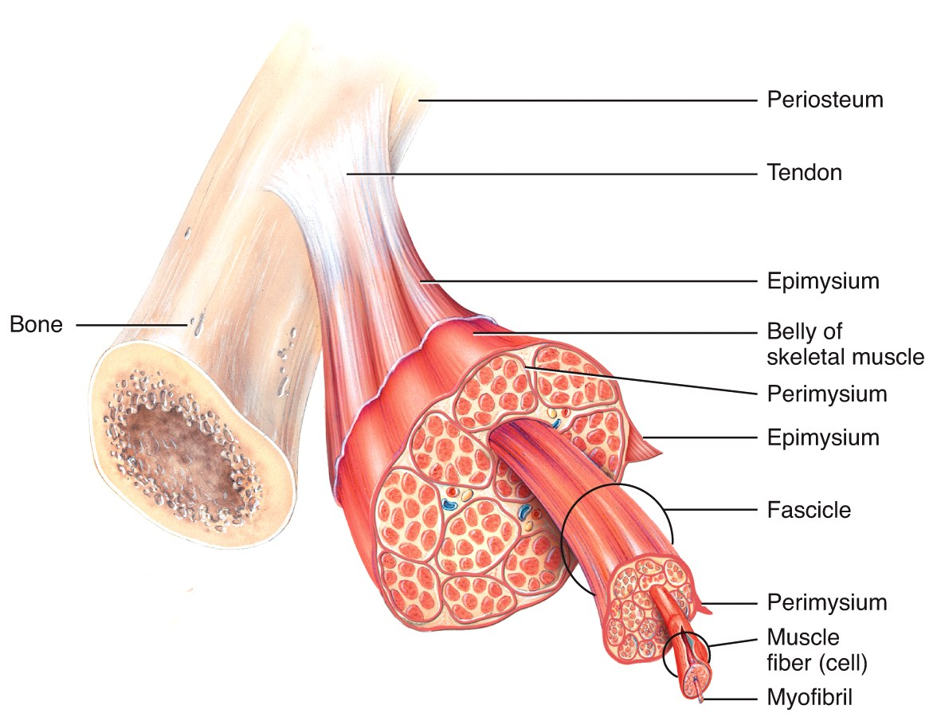
Organization of Muscle Tissue
A muscle, a fasciculus, and a fiber all visualized

Slide 13
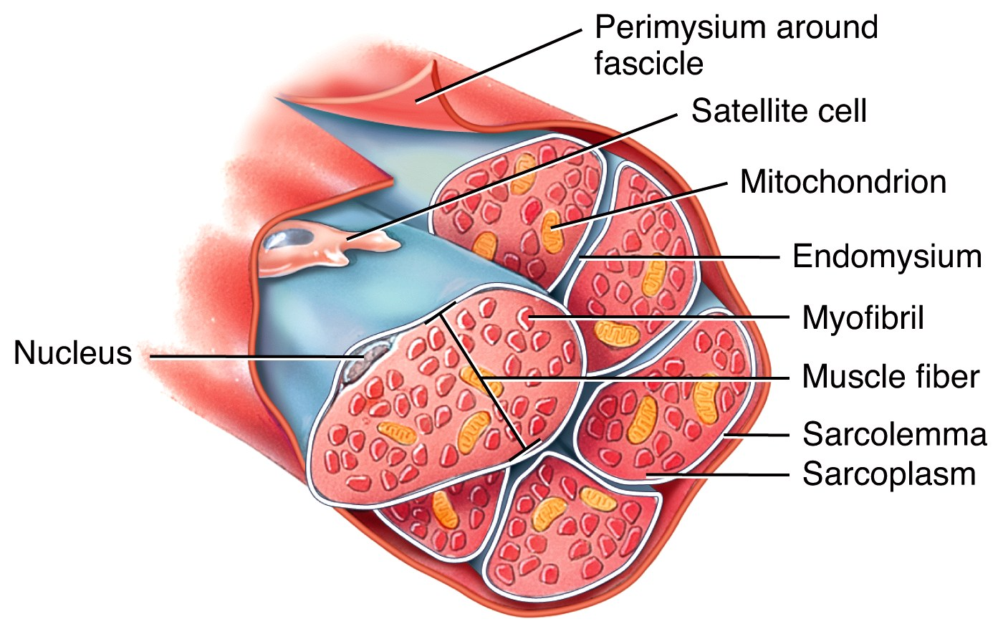
Organization of Muscle Tissue
Organization of a fasciculus

Slide 14
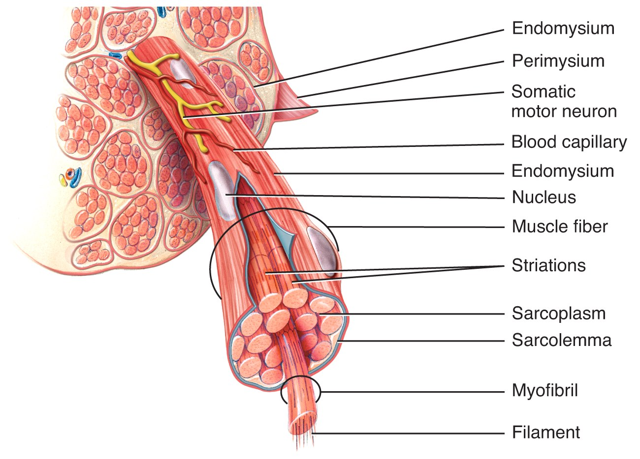
Organization of Muscle Tissue
Organization of a muscle fiber

Slide 15
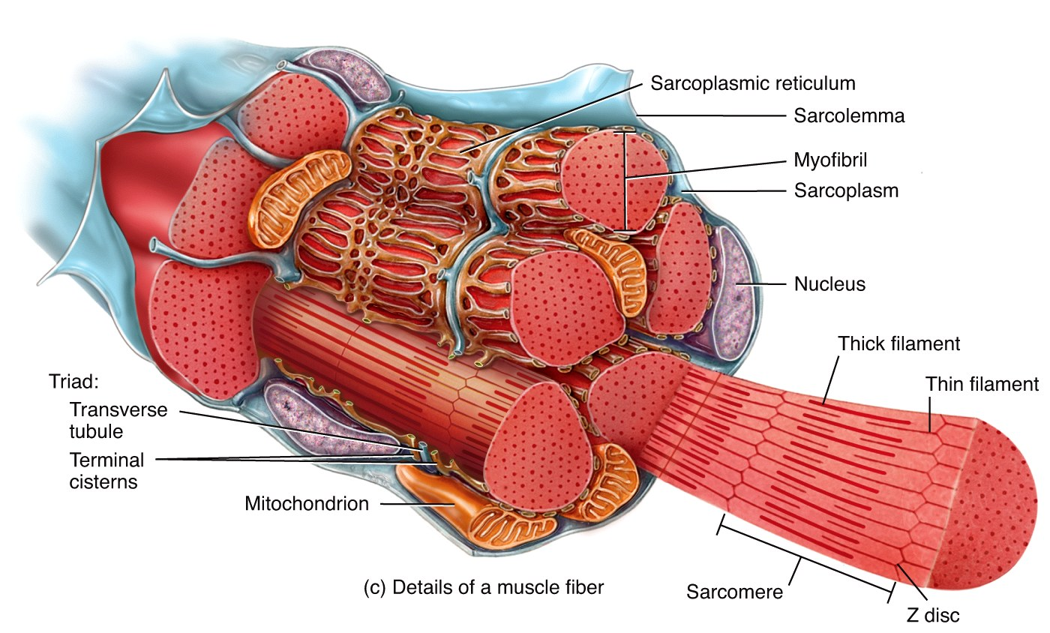
Skeletal Muscle Arrangement
A single muscle cell is a muscle fiber
  Fibers are made up of myofibrils
  Myofibrils are made up of thick and thin filaments
Sarcolemma – muscle cell membrane
Sarcoplasm
muscle cell
cytoplasm

Slide 16
Skeletal Muscle Cells
Myofibrils are striated
  Striations due to arrangement of thick and thin filaments
    Seen as alternating areas of light and dark bands
The length of each myofibril is divided into repeating units called sarcomeres
  A sarcomere is the functional unit of skeletal muscle

Slide 17
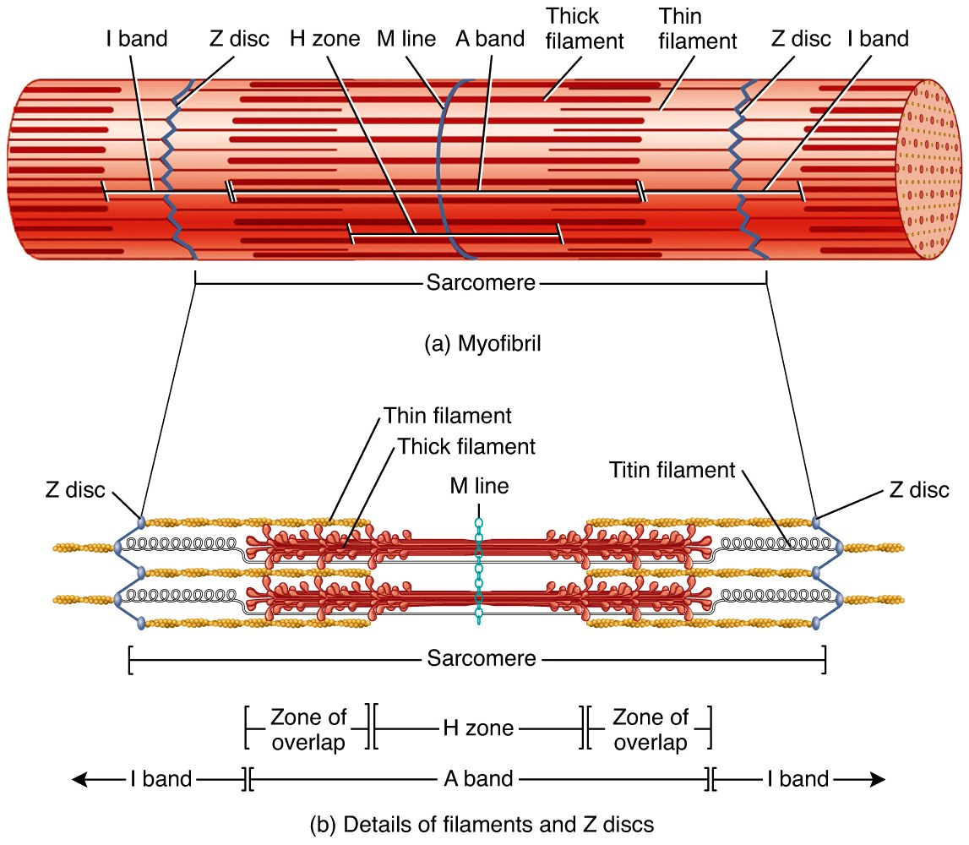
Sarcomere Arrangement

Slide 18
Sarcomere Structure
Sarcomere exists from Z-line to Z-line
A-Band is dark middle band
  Overlapping think and thin filaments
I-Band – ends of A-Band, thin filaments only
Z-line is in the middle if the I-Band
Myosin filaments are held to the Z-line by titin proteins

Slide 19
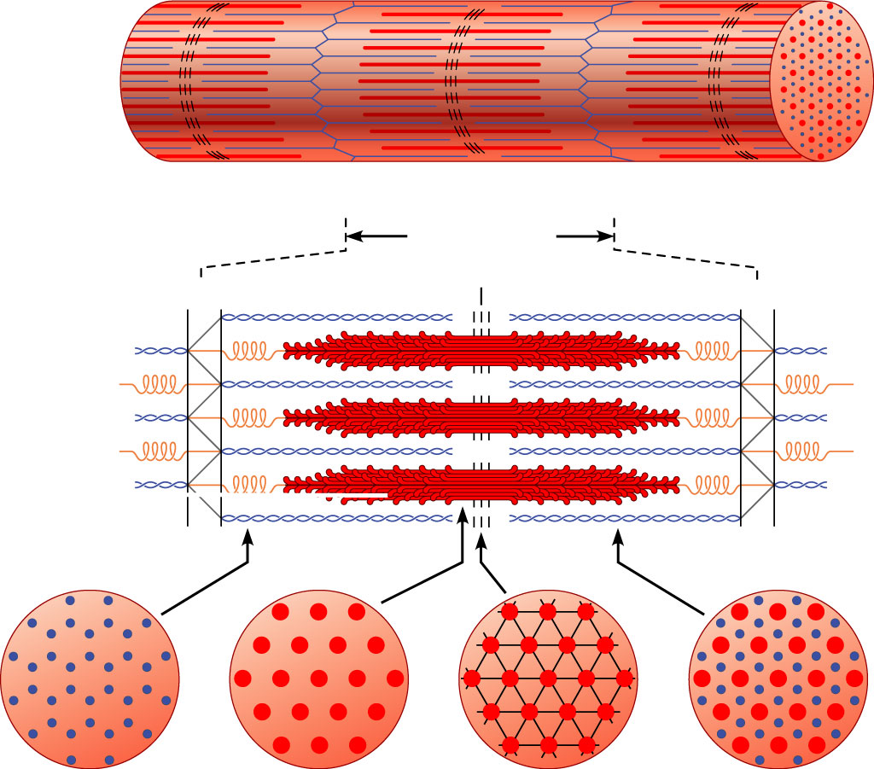
Microscopic anatomy of a skeletal muscle fiber
Z disc
H zone
Z disc
Thin (actin) filament
Thick (myosin)
filament
(c)
I band
A band
I band
M line
Sarcomere
Z disc
M line
Z disc
Thin (actin) filament
Elastic (titin)
filaments
Thick (myosin)
filament
(d)
I band
thin filaments
only
H zone
thick filaments
only
M line
thick filaments linked
by accessory proteins
Outer edge of
A band
thick and thin
filaments overlap
(e)

Slide 20
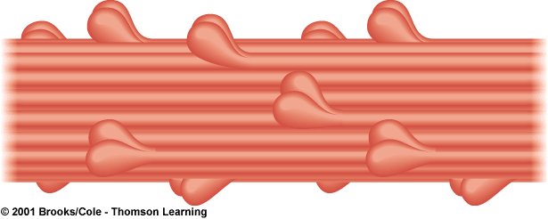
Thick Filament Structure
Composed of many myosin molecules
  Each myosin molecule has a tail region and 2 globular heads (crossbridges)

Slide 21
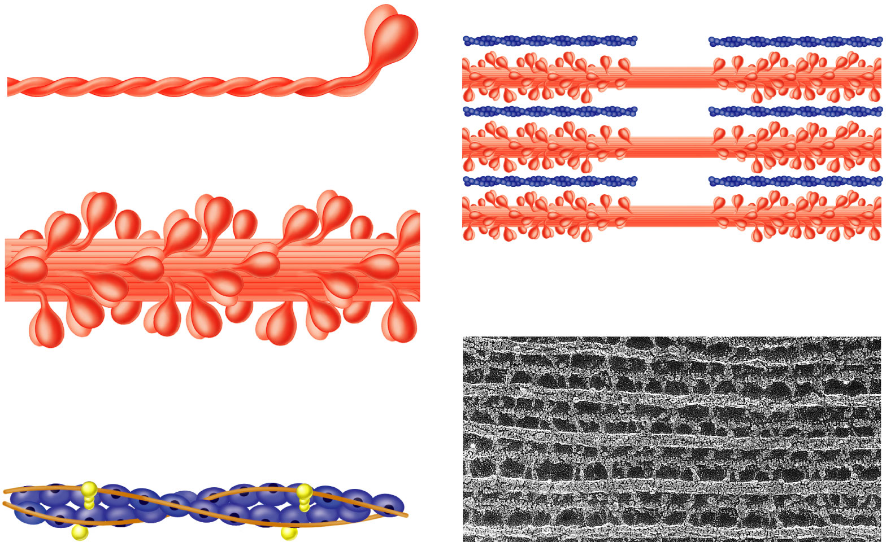
Thin Filament Structure
Composed of actin protein
  2 strands of globular actin molecules twisted into a helix
  Actin filaments have binding sites for myosin cross bridges
  Tropomyosin protein spirals around actin helix
  Troponin protein (3 subunits) is attached to actin and holds tropomyosin in place
    Call this the troponin-tropomyosin complex
Troponin complex
Tropomyosin
Actin

Slide 22
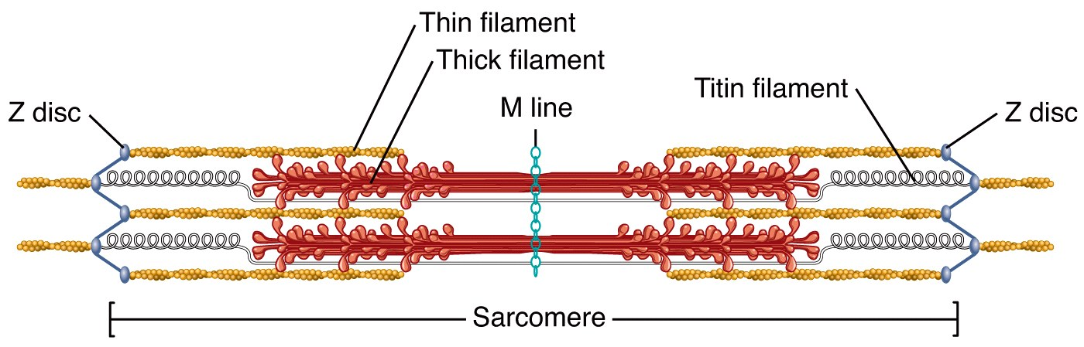

Slide 23
Specialized Organelles of Skeletal Muscle
Sarcoplasmic Reticulum (SR) – a type of ER
  Surrounds each myofibril, running parallel to it
  Stores calcium, when stimulated, calcium diffuses into sarcoplasm
Transverse Tubules (TT)
  Extends into sarcoplasm as invaginations continuous with sarcolemma
    T tubules run between cisternae of SR
  Filled with extracellular fluid
  Cisternae of SR and TT form a triad near where thick and thin filaments overlap

Slide 24
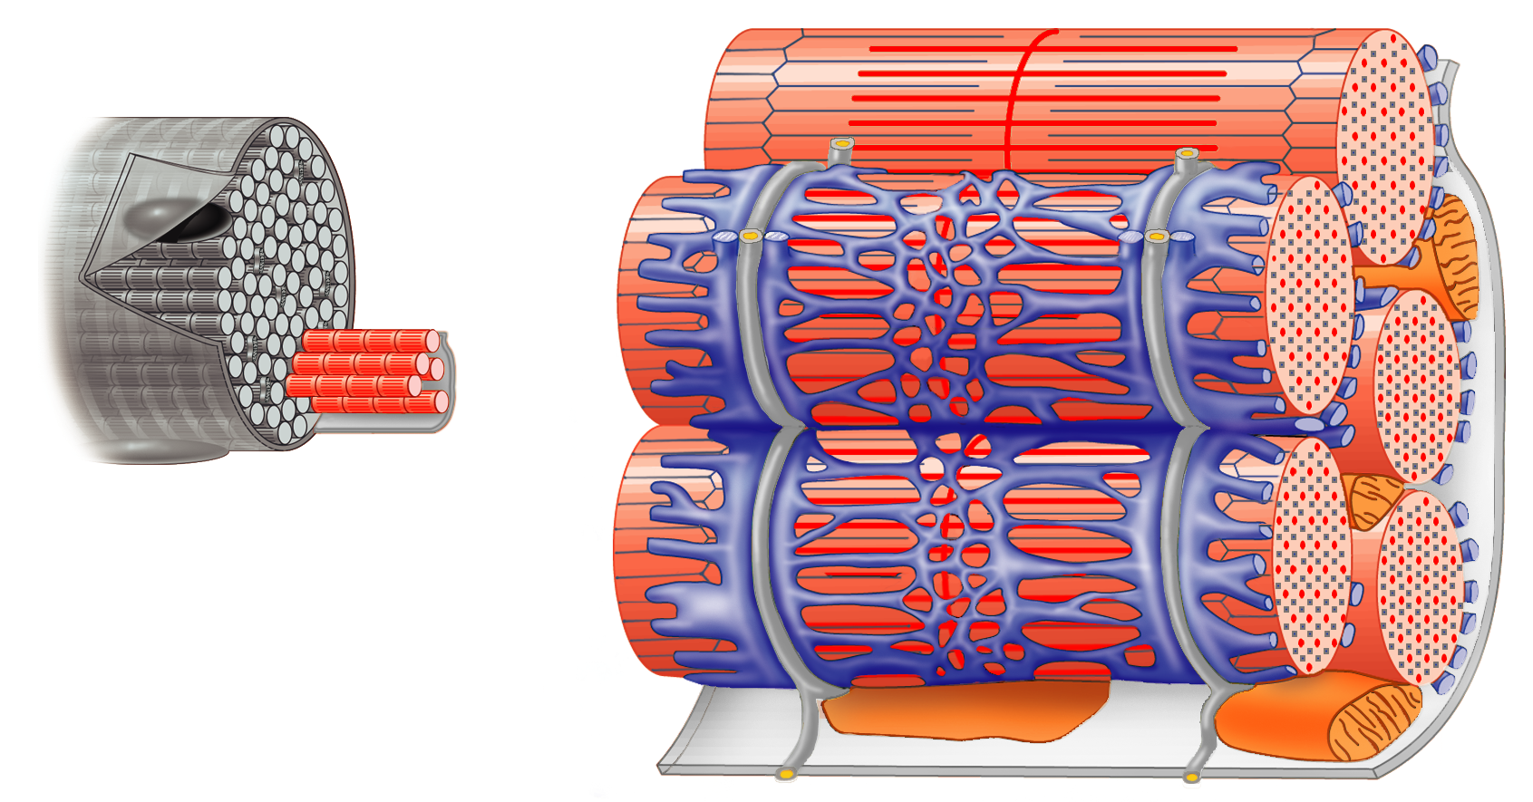
Relationship of the sarcoplasmic reticulum and T tubules to myofibrils of skeletal muscle
I band
A band
I band
Z disc
H zone
Z disc
M
line
Part of a skeletal
muscle fiber (cell)
Sarcolemma
Triad
Mitochondrion
Myofibrils
Myofibril
Tubules of
sarcoplasmic
reticulum
Sarcolemma
Terminal cisterna
of the sarcoplasmic
reticulum
T tubule

Slide 25



Three Types of Muscular Tissue
 | Location | Function | Appearance | Control
Skeletal | skeleton | movement, heat, posture | striated, multi-nucleated (eccentric), fibers parallel | voluntary
Cardiac | heart | pump blood continuously | striated, one central nucleus | involuntary
Visceral (smooth muscle) | G.I. tract, uterus, eye, blood vessels | Peristalsis, blood pressure, pupil size, erects hairs | no striations, one central nucleus | involuntary

Slide 26
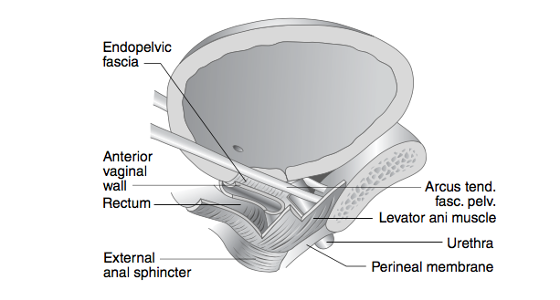
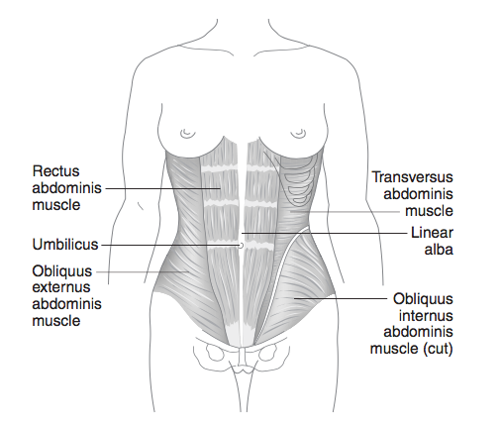
CONTOH OTOT PERUT DAN DASAR PANGGUL

Slide 27
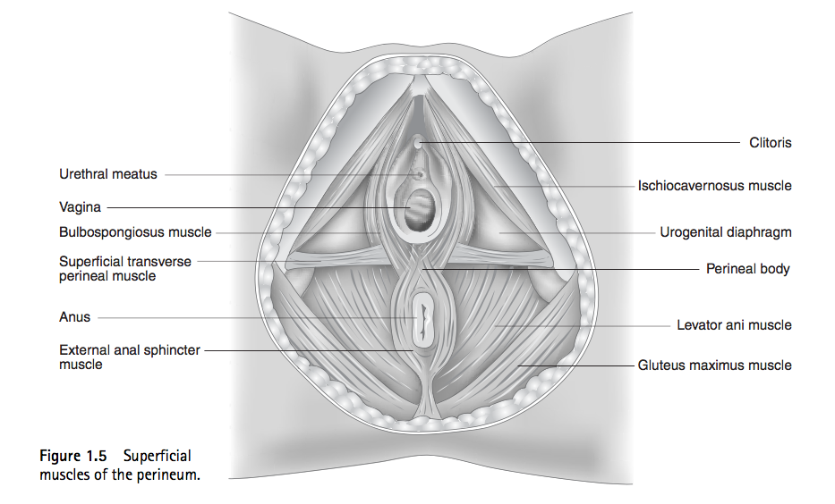
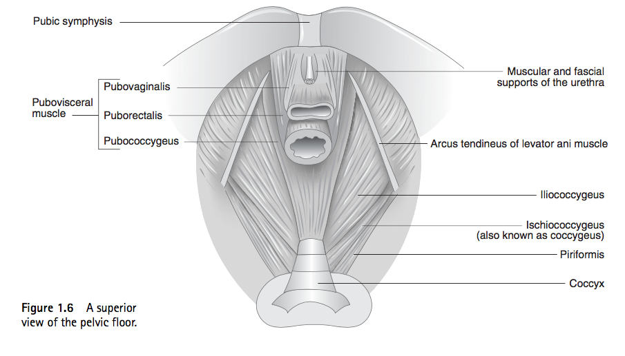

Slide 28
FUNGSI UTAMA
Sel otot kerja utamanya bukan kontraksi atau relaksasi
Melainkan merubah energi kimia ke energi mekanik

Slide 29
CONTRACTION -RELAXATION
Excitability
  responds to chemical messengers (neurotransmitters) released from nerve cells
Contractility
  can shorten and generate force
Extensibility
  can be stretched without damaging the tissue
Elasticity
  can return to original shape after being stretched

Slide 30
PERSYARAFAN DAN KONTRAKSI OTOT
Kontraksi didasarkan adanya 2 set filamen didalam sel otot kontraktil yg berupa filamen aktin dan filamen miosin. Rangsangan yg diterima o/asetilkolin menyebabkan aktomiosin mengerut (kontraksi). Kontraksi ini memerlukan energi
Pd wktu kontraksi, filamen aktin meluncur diantara miosin ke dlm zona H (zona H ada bagian terang diantara 2 pita gelap). Dengan demikian serabut otot memendek yg tetap panjang ban A (pita gelap), sedangkan ban I (pita terang) dan zona H bertambah pendek wkt kontraksi.

Slide 31
SYARAF & PERDARAHAN
Setiap otot mempunyai 1 syaraf, 1 arteri dan 2 vena
Setiap motor neuron mensuplai multiple serat otot di neuromuskular
Setiap sel otot disuplai oleh 1 motor neuron terminal branch dan dihubungkan dengan 1 atau 2 pembuluh kapiler
  Serat syaraf & kapiler ditemui pada endomisium diantara 2 individual sel

Slide 32
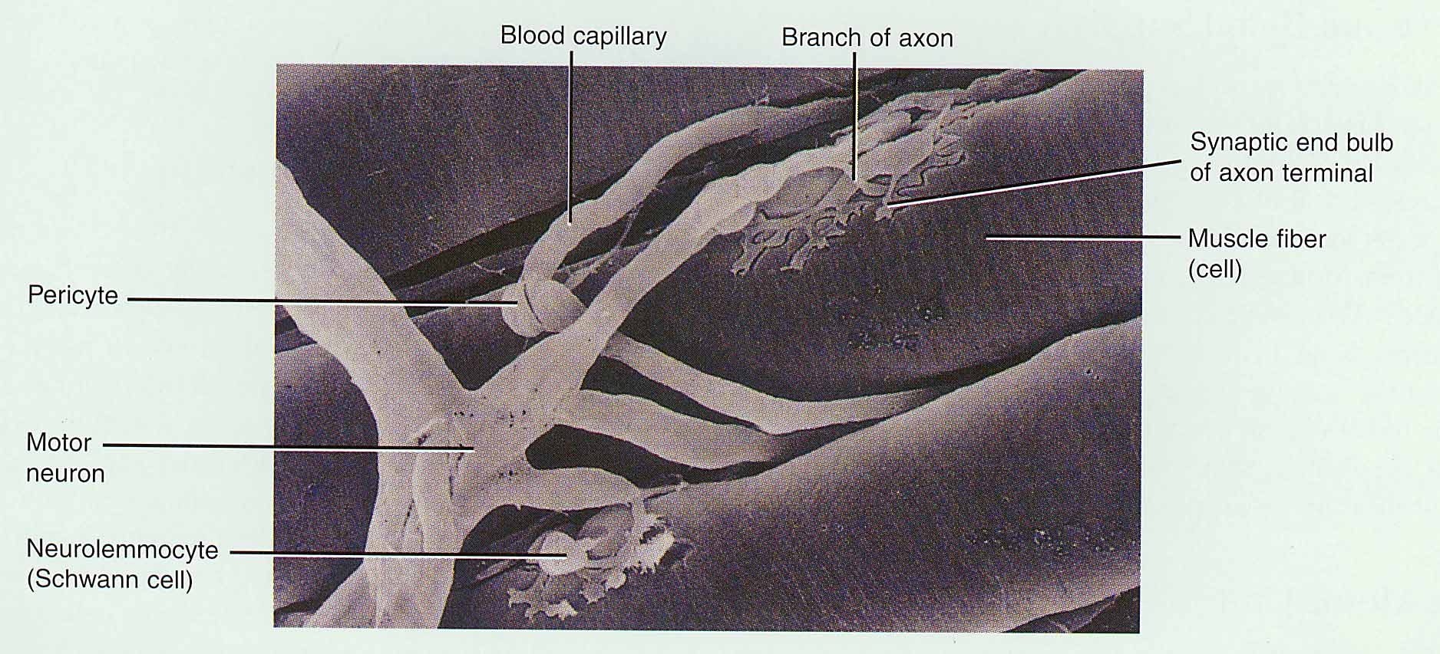
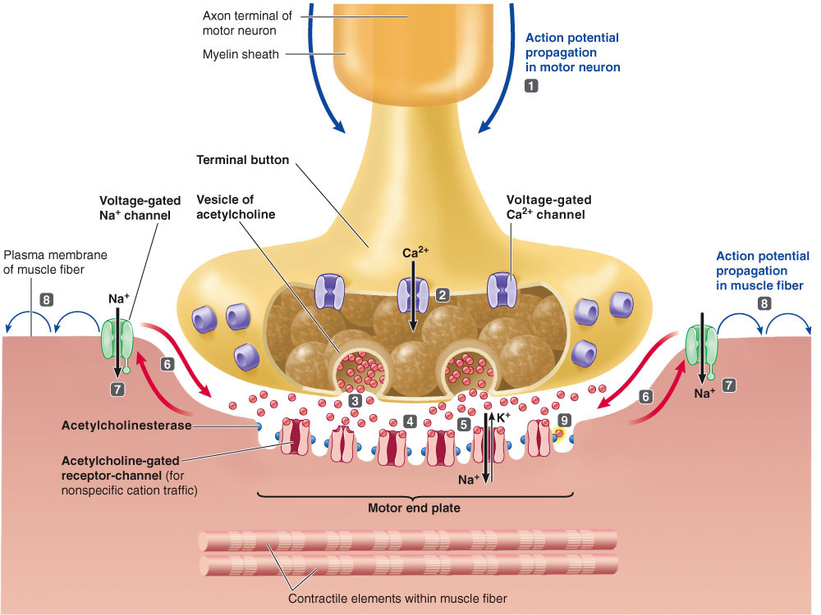
NEUROMUSCULAR JUNCTION

Slide 33
Neuromuscular junction
(example of chemical synapse)
Neuromuscular junction : the synapse between motor neuron and muscle fiber is called the neuromuscular junction
Motor neurons : are the nerves that innervate muscle fibers
Motor unit : single motor neuron and the muscle fibers it innervate

Slide 34
Bagaimana kontraksi dimulai?
Impuls syaraf memberi isyarat pada terminal akson; vesikel sinaptik melepaskan acetylcholine (ACh)
ACh menyebar ke reseptor di sarkolemma
Potensial aksi otot (perubahan potensial membran) menyebar ke sarkolemma dan turun ketubulus tranversus
SR/Triad melepaskan Ca⁺² ke saroplasma
Ini adalah excitation / rangsangan

Slide 35
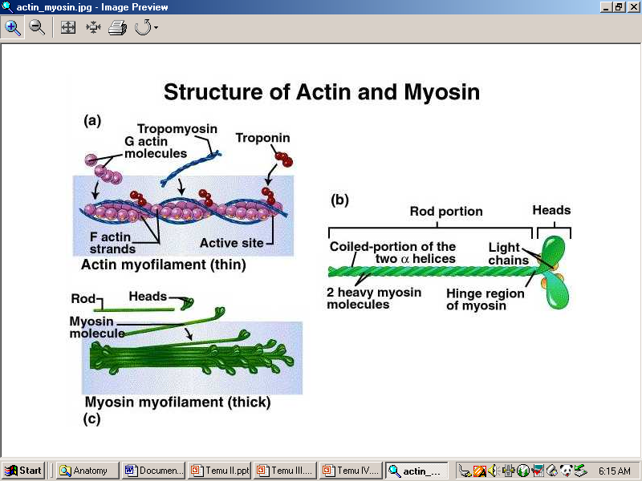
SLIDING FILAMEN

Slide 36
MOVEMENT -STABILIZATION
OTOT MENEMPEL PADA TULANG (ORIGO DAN INSERSIO)
BERKERJA KARENA ADANYA SERABUT SARAF (KOORDINASI GERAK)
DALAM GERAKAN FUNGSINAL BERSIFAT AGONIS DAN ANTAGONIS
DALAM KESEIMBANGAN AGONIS DAN ANTAGONIS MENGHASILKAN STABILISASI SENDI DAN GERAKAN YANG TEPAT

Slide 37
SKELETAL : TULANG, BONE, OSteo
Consists of bones & joints

Slide 38
Bones
Structure & Function
Bones
Composed of osseous tissue
Consists of a rich supply of blood vessels and nerves
Osteoblasts are bone-forming cells
Osteoclasts are responsible for reabsorbing dead bone tissue
Bone cells are called osteocytes

Slide 39
Ossification
Skeletal : Structure & Function
Bones
The development of osteocytes and the hardening process is called ossification.
Ossification depends on:
calcium
vitamin D
phosphorus

Slide 40
Common Bone Categories
Structure & Function
Bones
The adult skeleton has 206 bones.
Common Bone Categories :
    Long Bones
    Short bone
    Flat bone
    Irregular Bones
    Sesamoid bones

Slide 41
Parts of Long Bones
Structure & Function
Bones
Parts of long bones:
The shaft is the longest portion also called the diaphysis.
The ends are called the epiphysis.
Space between the epiphyses and the diaphysis is called the metaphysis.

Slide 42
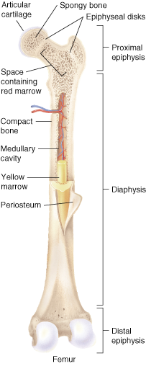
Parts of Long Bones Part 2
Parts of a long bone
Articular cartilage
Spongy bone
Epiphyseal disks
Space containing red marrow
Proximal epiphysis
Compact bone
Medullary cavity
Articular cartilage is a thin flexible substance that provides protection at movable points.
Medullary cavity contains yellow bone marrow.
Red bone marrow is found in infant bones and the flat bones of adults.
Yellow marrow
Diaphysis
Periosteum
Distal epiphysis
Femur

Slide 43
Cranial Bones
Cranial Bones

Slide 44
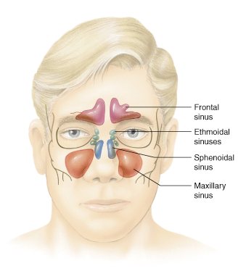
Sinuses
Sinuses are cavities that reduce the weight of a bone.
Frontal sinuses
Ethmoid sinuses
Maxillary sinuses
Sphenoid sinuses

Slide 45
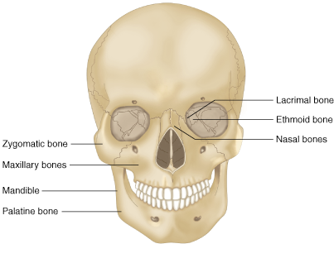
Facial Bones
Facial Bones
Lacrimal bone
Ethmoid bone
Nasal bones
Zygomatic bone
Maxillary bones
Mandible
Palatine bone

Slide 46
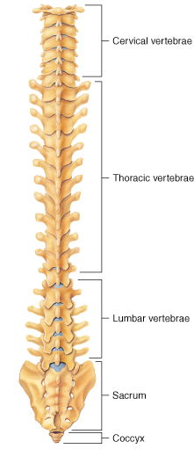
Spinal Column
Spinal Column
Consists of five sets of vertebrae
Cervical = 7
Thoracic = 12
Lumbar = 5
Sacrum = 5
Coccyx = 1

Slide 47
Medula Spinalis

Slide 48
Bones of the Chest
Bones of the Chest
The chest cavity is also referred to as the thoracic cavity.

Slide 49
Bones of the Pelvis
Bones of the Pelvis
ilium
ischium
pubes
pelvic cavity
The pubic symphysis is where both pubic bones join.

Slide 50
Bones of the Extremities
Bones of the Extremities
Upper Arm
Lower Arm
Humerus
Ulna
Radius

Slide 51
WRIST & LOWER ARM

Slide 52
Bones of the Extremities Part 2
Bones of the Extremities (Cont’d)
Upper Leg
Lower leg
Femur
Tibia (shin)
Fibula
Patella (kneecap)

Slide 53
FEET AND TOES

Slide 54
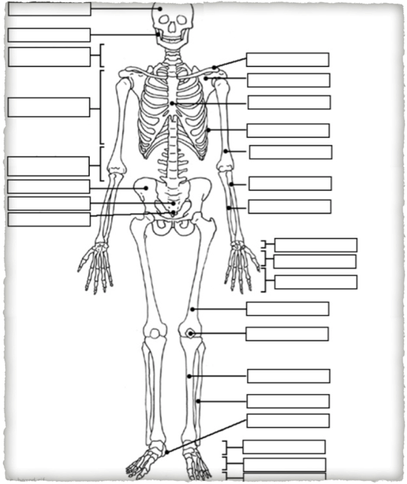
ISILAH NAMA NAMA TULANG DALAM KOTAK

Slide 55
Joints
Structure & Function
Amphiarthroses
Diarthroses
Moves slightly
Moves freely
Joints (articulations)
Synarthroses
No movement

