Slide 1
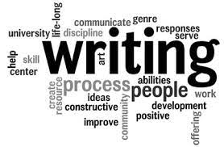
Writing an Academic Essay
Miss Nor Faizah Kaeni, M.A.

Slide 2
What are the steps you do when you have to write an essay?
https://padlet.com/norfaizahkaeni/l1aw2wryzgpsncdh

Slide 3
STAGES IN WRITING AN ESSAY
Pre-Writing
Planning and Outlining
Writing a First Draft
Redrafting and Revising
Editing and Proofreading

Slide 4
Pre-Writing
Understand the essay assignment (to inform, to persuade, to argue, to evaluate?)
Consider the length of the essay, rules of writing such as the citation system by checking in your library and writing style
Make sure that the topic is relevant (pre-writing will help you narrow the topic)
Do a brainstorming by reading relevant texts (journals, news, books, articles etc)
Review your plan by making outlines

Slide 5
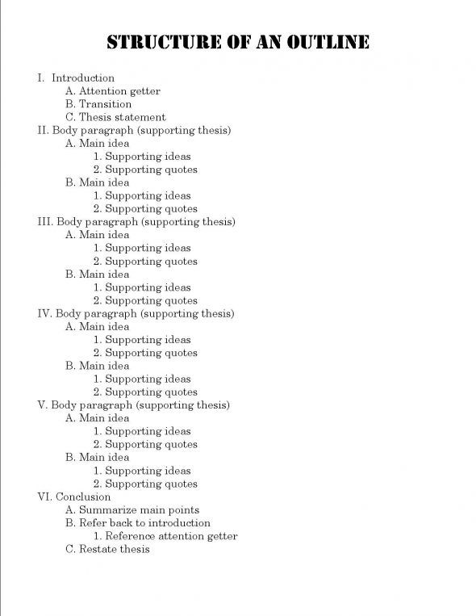
Planning and Outlining
Create an outline
Use bullets or else to jot down your ideas and make it clear
Try this:
- Tik Tok: Useful or Harmful?
- Having Pets: Cats or Fish?
- What country do you really want to visit? Why?
https://padlet.com/norfaizahkaeni/vpfhj47t94vg2fo3

Slide 6
Writing an Early Draft
Start writing your draft based on your outline you have made
It is reasonable to begin writing the body of your essay and save the introduction for later after you have clear ideas on your body of essay
Use systematic paragraph writing. How?
Introduce the point of the paragraph with the topic sentence.
Provide evidence relating to your argument.
Explain or interpret the evidence.
Finally, express the conclusion

Slide 7
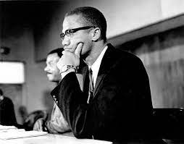
Redrafting and Revising
Look critically to your draft and find some areas needing improvement to freshen up your perspectives.
Focus on some larger issues such as:
- unclear or illogical arguments
- poorly ordered information
- incomplete or short passages (need more explanation)
- irrelevant passages

Slide 8
Editing and Proofreading
Editing
Adjust your diction (choice of words)
Delete irrelevant details
Punctuate words or sentences
Coordinate or subordinate ideas
Emphasize important points or ideas
Add appropriate transitions (link words)
Proofreading
Request a proofread from other people before publishing

Slide 9
BASIC ESSAY STRUCTURE
INTRODUCTION
BODY
CONCLUSION
5% (of word count)
100 words
90% (of word count)
200 words
400 words
600 words
600 words
5% (of word count)
100 words

Slide 10
Introduction
The 1st sentence is important, so gain the attention of the reader with a hook
Start with something interesting such as question
Use a vivid quotation
Relate to an incident or phenomena
Offer a surprising fact
Outline a problem
Provide background
Start with a dialogue
Define terms significant to the subject (avoid a dictionary definition)
State an opinion related to the thesis
Place the subject within a historical context
Open with an anecdote
Create a visual image
Shock or provoke the reader – mildly
All those must be relevant
Provide thesis statement

Slide 11
Thesis Statement

Slide 12
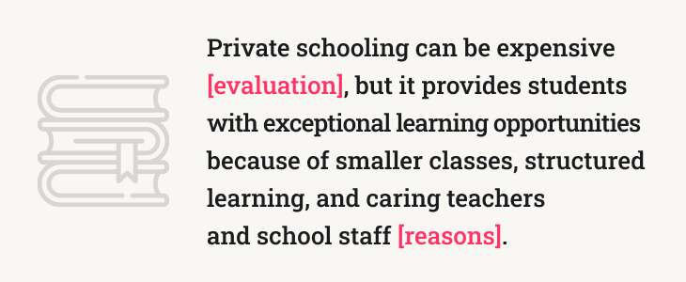
Thesis Statement

Slide 13
Thesis statement CANNOT ………..
BE A QUESTION
BE AN INCOMPLETE SENTENCE
BE A FACT
HAVE MORE THAN ONE CONTROLLING IDEA

Slide 14
What would be your thesis statement for these topics?
- what is the most important thing to improve in a country to create a strong and wealthy nation?
- should plastic be banned?
- Zoo: good or bad?
- countryside or city?
- money and friendship
Join:
https://padlet.com/norfaizahkaeni/nayk7wh3dngum9vo

Slide 15
Structure – Body and Paragraphing
Thesis statement frames these sections and position of the paper
Divide into sections by analyzing the task. Sections are divided into sequenced paragraphs.
The argumentation must be linear meaning that we have to follow the sequence provided by the thesis statement.
In the body of your essay, begin with topic sentence for each paragraph to let the reader know what to expect from the paragraph
Make a clear statement about the topic
All sentences should support the topic sentence
You may use examples, figures, illustrative stories, expert testimonies, personal experience, data and graphs,
Make sure you know the citation system by checking in your library
It is important to use transition words when needed. Transition words or phrases guide the reader from one idea to another
It helps establish the chronological sequence in a narrative, connect examples, and move between steps in a process

Slide 16
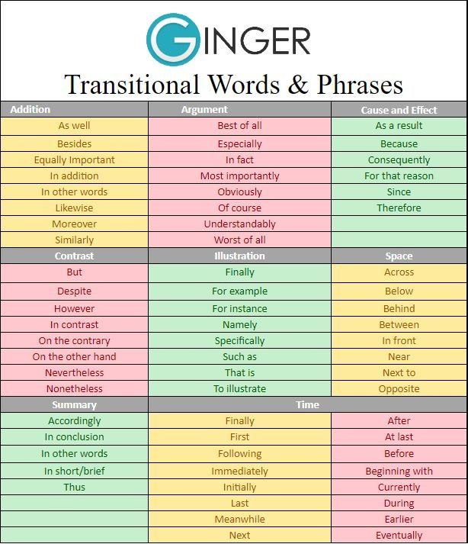
Transition
…………….. the emergence of Covid-19 pandemic, people neglect the habit of washing hands. (Where / Before / Thus)
One reason for people to have pets is for companionship; …………..is for protection. (Once / Frequently / Another)
…………Instagram is a new social media; it has quickly become extremely popular. (Although / When / As a result)

Slide 17
Paraphrasing
Read carefully
Make sure you understand the point of the quotation.
Outline the idea
Change the structure of the sentence. You may use synonyms but make sure it is relevant. Just take your time. It may need some times to do a paraphrase.
Try : https://handymandanonline.com/Paraphrasing-tool/Index.html

Slide 18
Conclusion
Wrap up by providing a logical finish to the paper.
Avoid adding new material.
Refer clearly to the question/main topic/thesis statement.
Summarize briefly. → Don’t stop here. Instead, provide the readers conclusion which they can take (Readers: What do I know now after reading the essay?
It may offer suggestion or future prevention

Slide 19
Tips to Improve Your Writing

Slide 20
1. Do not use contractions
Use
Do not
Cannot
Should not
Could not
Would not
Is not
Have not
Has not
Will not
Do not use
Don’t
Can’t
Shouldn’t
Couldn’t
Wouldn’t
Isn’t
Haven’t
Hasn’t
Won’t

Slide 21
2. Avoid there is / there are
Do not use
There are many issues that students face at university.
Use
Students face many issues at university
Do not use
There are many development projects that the UN supports.
Use
The UN supports many development projects.

Slide 22
3. Avoid using the words: really, very, a lot, so
Do not use
Many students think university is very hard.
Use
Many students think university is difficult.
Do not use
Death sentence is really controversial.
Use
Death sentence is controversial.
Do not use
A lot of students face difficulties in writing essays.
A lot of time is wasted.
Use
Many students face difficulties in writing essays.
Much time is wasted.

Slide 23
4. Passive Voice vs Active Voice
Analyze the sentences!
Healthcare reforms were implemented by the government.
The government implemented healthcare reforms
Analyze the sentences!
The experts found the vaccines.
The vaccines were found by the experts.

Slide 24
5. Use Strong Verbs
Strong verbs show action that your reader can easily imagine
Good writing has life, energy, and detail and strong verbs add these qualities to your writing
1. Weak verbs: to be (am, is, are, was, were etc)
To be verbs are weak verbs. They do not show action.
2. Weak verbs: verb + adverb
Sometimes, people add adverbs to liven up their writing, but really, a strong verb is more effective than a verb + adverb.
Instead of…… | Try……
Malaysia is a beautiful country. | Malaysia has many interesting places to visit.
The weather is nice. | The sun shines brightly during summer.
English is very difficult. | English challenges the ability to comprehend the usage of correct verbs.
Instead of…… | Try……
People spoke quietly during the speech. | People whispered during the speech.
Children ran quickly when we came. | Children sprinted when we came.

