Slide 1
Tips and tricks on toefl reading comprehension

Slide 2
50 QUESTIONS OF MULTIPLE CHOICE for 55 MINUTES
CONSIST OF 5 TEXTs OR PASSAGEs
READING

Slide 3
TIPS AND TRICK ANSWERING TOEFL READING COMPREHENSION
VOCABULARY
TOEFL READING SKILLS
TIME MANAGEMENT OR TIMING
CONCENTRATION

Slide 4
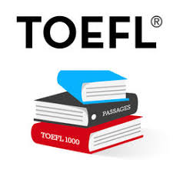
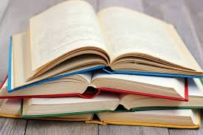
VOCABULARY
READ, READ, READ!!!
SKIMMING AND SCANNING METHOD
VERBS AND ADJECTIVES

Slide 5
MAIN IDEA / TOPIC:
SKIMMING (p.1 & p.T)
TOEFL READING SKILLS
OVERALL REVIEW:
True and false statement
QUESTION TYPES:
DETAIL:
WH questions
(who, when, where, what, how)
VOCABULARY:
Meaning
The shield will save us from crash.
What is the closest meaning of SHIELD?
Protector
Executor
Defender
Savior
REFERENCE:
People always bring a lot of stuffs when they go vacation. They also prepare some meals and snacks with them.
stuffs
People
Snacks
Meals

Slide 6
SCANNING
SKIMMING
A Reading technique to be used when you want to find specific information quickly
A Reading technique mean to look for main or general ideas. Without going into detailed reading. It will save you lots of time

