Slide 1
ENGLISH FOR DAILY USAGE
RADIOLOGY UNISA
David S Aditya

Slide 2
Learning goals
To adapt with online learning, some considerations need to cope
1
Familiar with English used in daily conversation
2
English language test

Slide 3
Technology orientation
This semester learning:
Elearning.unisayogya.ac.id -means- doing tasks means attending class
Synchronous: Zoom
Present 10 minutes before class. Video on.
1

Slide 4
How to be an independent learner
Have a good timeline of learning.
Independently have initiatives to find learning sources:
Youtube, britishcouncil, elllo,

Slide 5
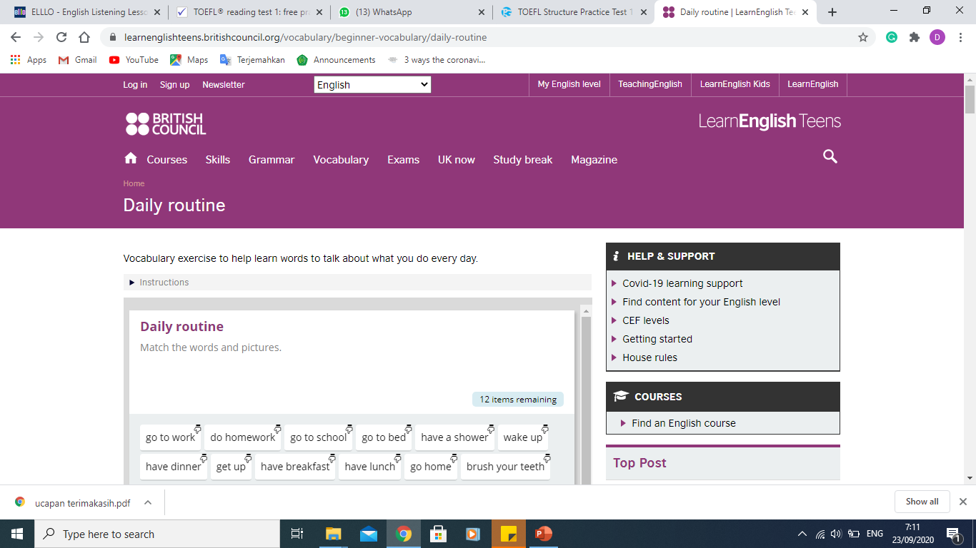
Technology orientation

Slide 6
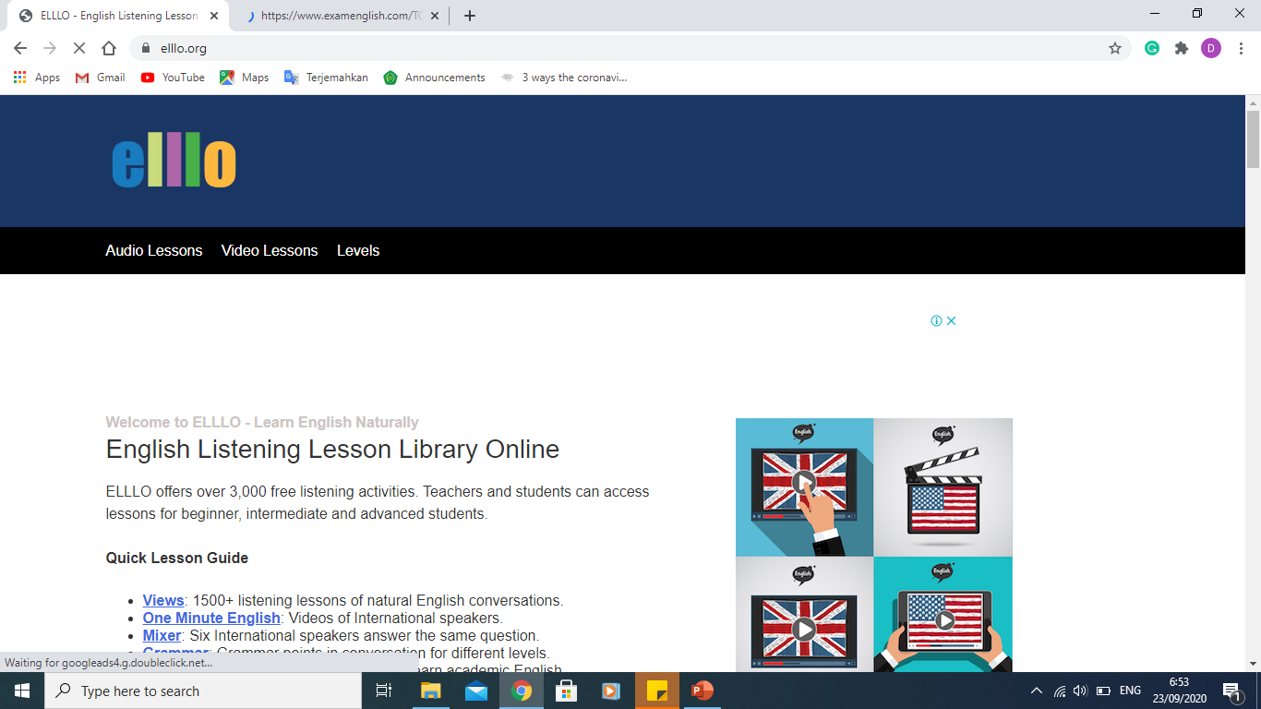
Learning sources

Slide 7
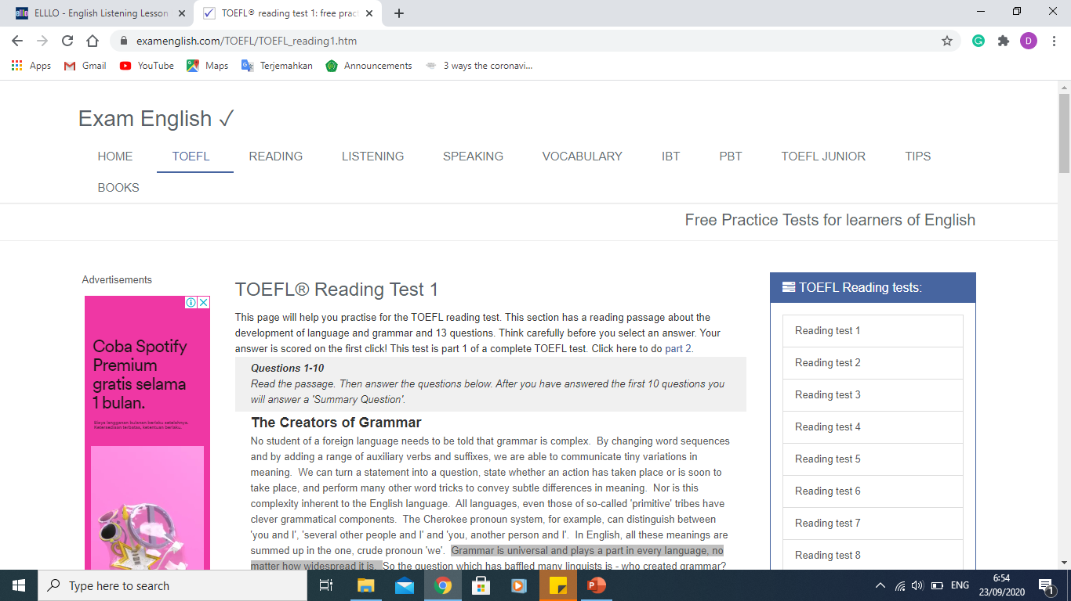
Learning sources

Slide 8
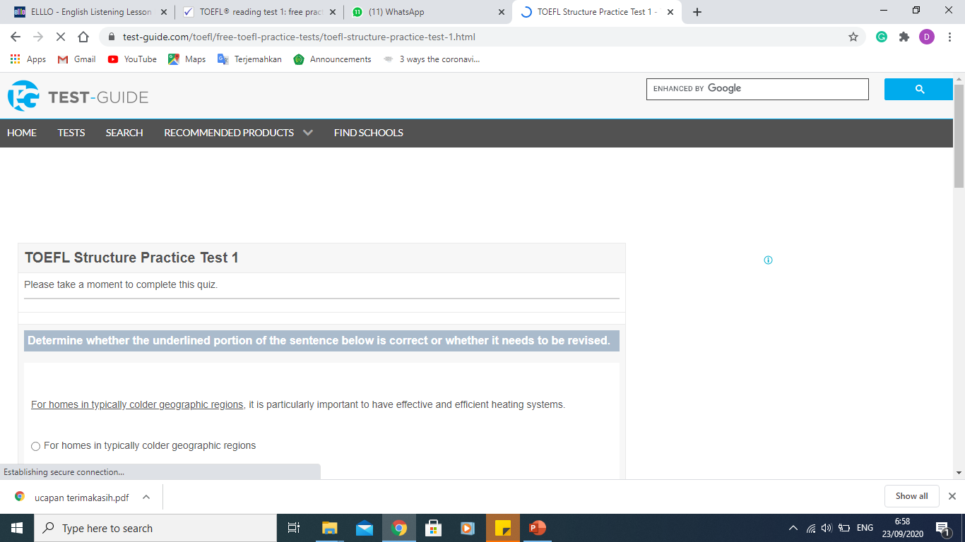
Technology orientation

Slide 9
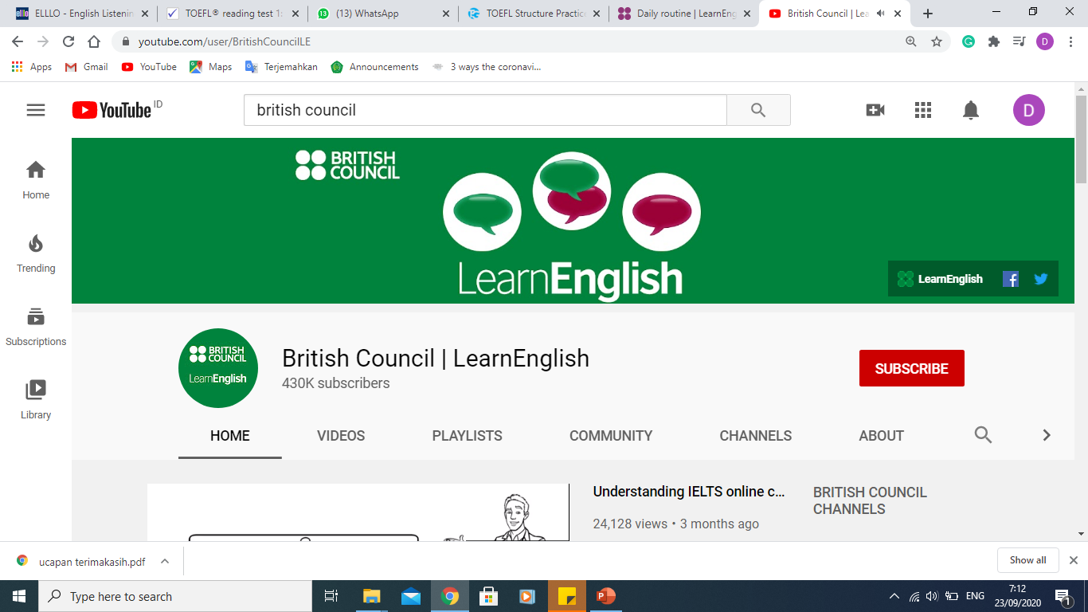

Slide 10
Thank you
davidsaditya@unisayogya.ac.id

