Slide 1
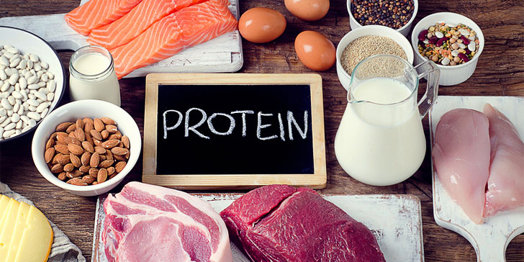
Protein and Amino Acids
Arif Yusuf Wicaksana, M.Sc., Apt

Slide 2
Do’a Sebelum Belajar

Slide 3
TUJUAN PEMBELAJARAN/ LO/
CAPAIAN PEMBELAJARAN
Mahasiswa mampu menjelaskan protein dan asam amino beserta metabolismenya serta menerapkan pemeriksaan laboratorium protein

Slide 4
Al-Maidah (5) : ayat 87

Slide 5
Journal / Literature

Slide 6
Learning Chapter
Protein and amino acids metabolism
Protein and amino acids profil in human body
Amino acid metabolism disorders

Slide 7
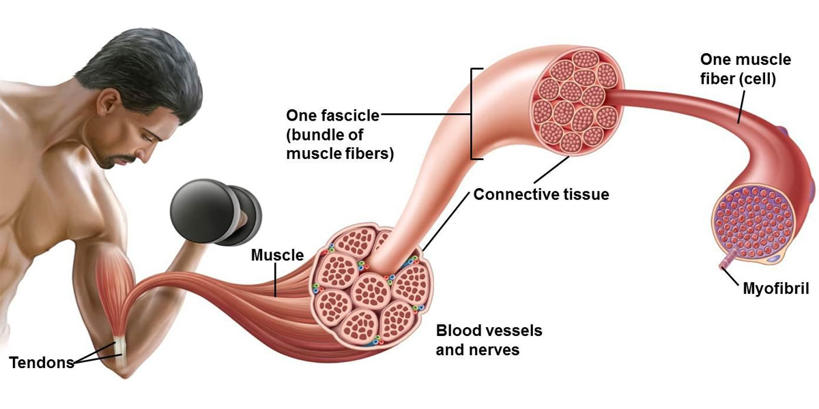
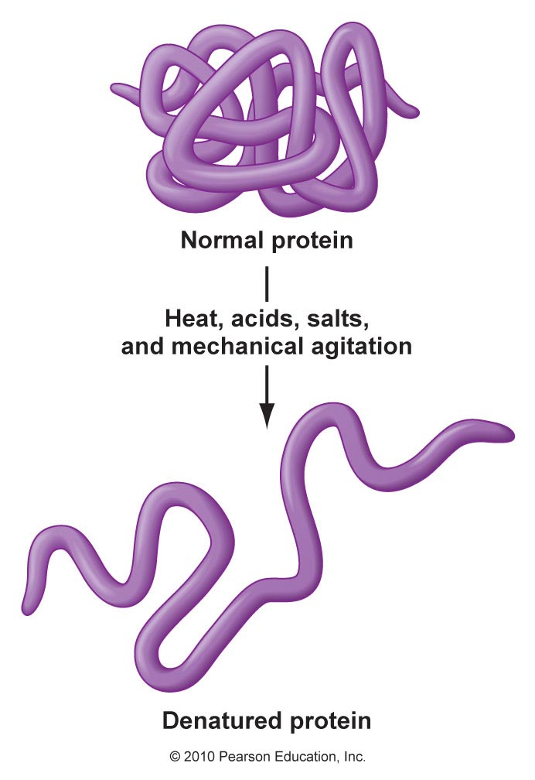
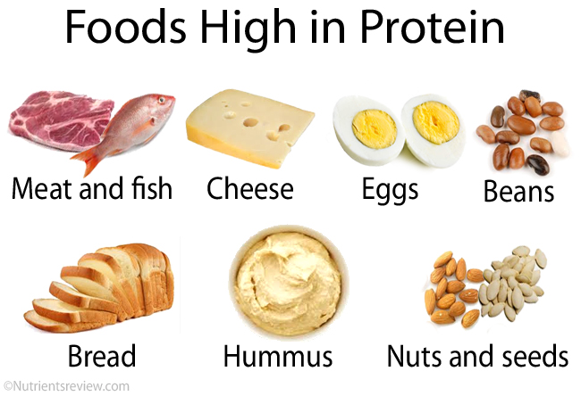
Notes:
Kebanyakan protein merupakan enzim atau subunit enzim. Jenis protein lain berperan dalam fungsi struktural atau mekanis, misalnya protein yang membentuk batang dan sendi sitoskeleton. Protein terlibat dalam sistem imun sebagai antibodi, sistem kendali dalam bentuk hormon, sebagai komponen penyimpanan (dalam biji) dan juga dalam transportasi hara. Sebagai salah satu sumber gizi, protein berperan sebagai sumber asam amino bagi organisme yang tidak mampu membentuk asam amino tersebut (heterotrof).

Slide 8
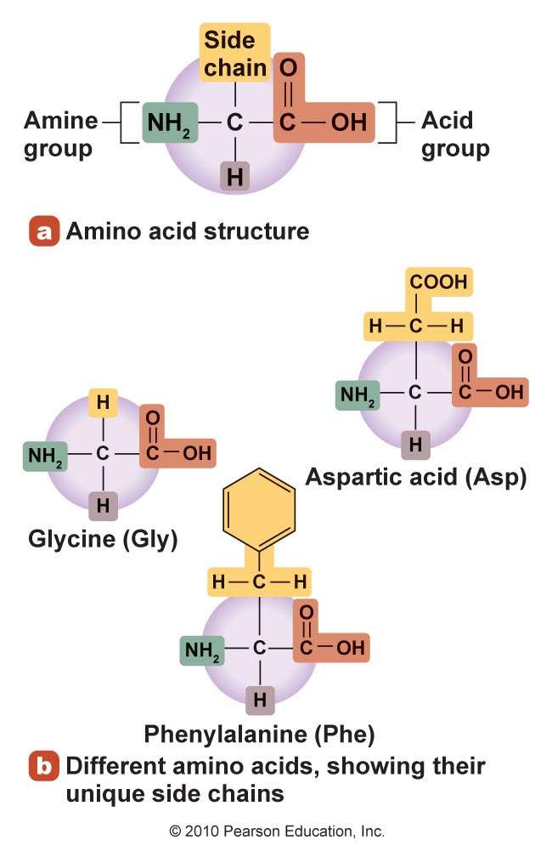
What Are Proteins?
Large molecules
Made up of chains of amino acids
Are found in every cell in the body
Are involved in most of the body’s functions and life processes
The sequence of amino acids is determined by DNA
Notes:
Protein (asal kata protos dari bahasa Yunani yang berarti "yang paling utama") adalah senyawa organik kompleks berbobot molekul tinggi yang merupakan polimer dari monomer asam amino yang dihubungkan satu sama lain dengan ikatan peptida. Molekul protein mengandung karbon, hidrogen, oksigen, nitrogen dan kadang kala sulfur serta fosfor. Protein berperan penting dalam struktur dan fungsi semua sel makhluk hidup dan virus.

Slide 9
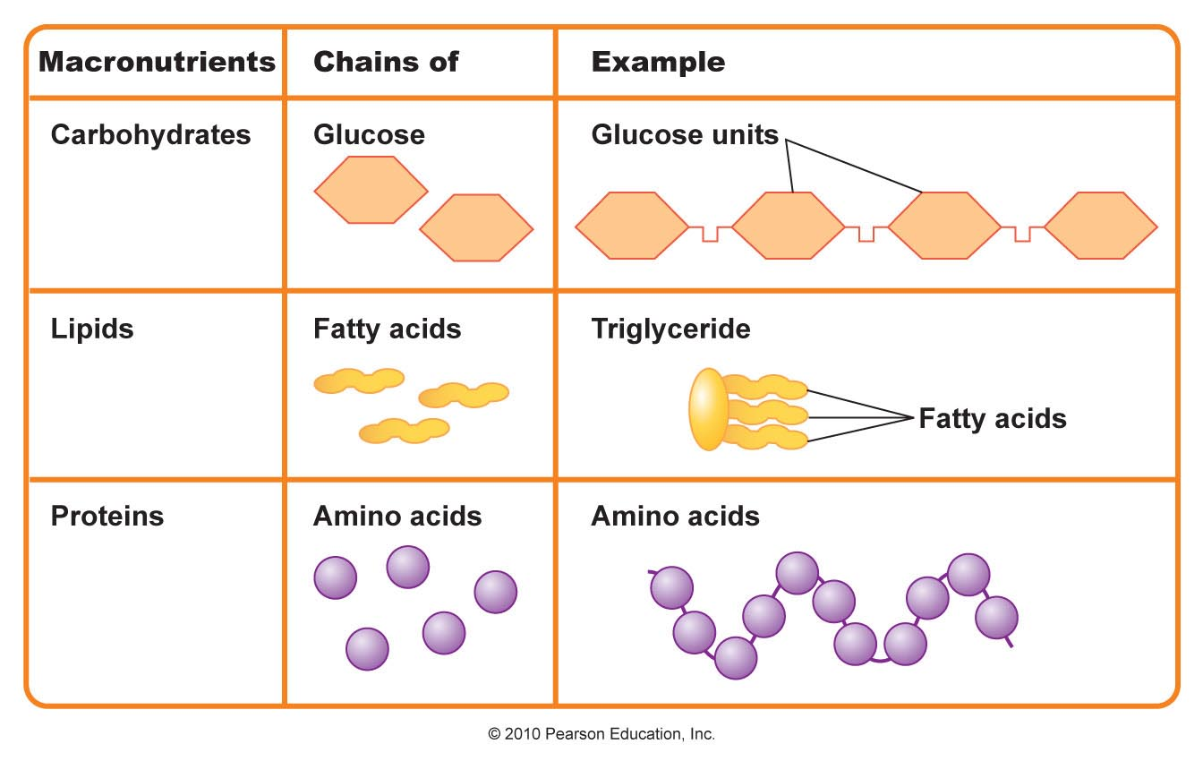
Notes:
Protein merupakan salah satu dari biomolekul raksasa, selain polisakarida, lipid, dan polinukleotida, yang merupakan penyusun utama makhluk hidup. Selain itu, protein merupakan salah satu molekul yang paling banyak diteliti dalam biokimia. Protein ditemukan oleh Jöns Jakob Berzelius pada tahun 1838.
Biosintesis protein alami sama dengan ekspresi genetik. Kode genetik yang dibawa DNA ditranskripsi menjadi RNA, yang berperan sebagai cetakan bagi translasi yang dilakukan ribosom.^{[1]} Sampai tahap ini, protein masih "mentah", hanya tersusun dari asam amino proteinogenik. Melalui mekanisme pascatranslasi, terbentuklah protein yang memiliki fungsi penuh secara biologi.^{[2][3]}

Slide 10
Structure of Proteins
Made up of chains of amino acids; classified by number of amino acids in a chain
Peptides: fewer than 50 amino acids
Dipeptides: 2 amino acids
Tripeptides: 3 amino acids
Polypeptides: more than 10 amino acids
Proteins: more than 50 amino acids
Typically 100 to 10,000 amino acids linked together
Chains are synthesizes based on specific bodily DNA
Amino acids are composed of carbon, hydrogen, oxygen, and nitrogen

Slide 11
AMINO ACID STRUCTURE
Non-ionized form
H
O
H₂N
C
C
Amino
group
Carboxyl
group
OH
R
Side chain
Notes:
Figure: 3.3a, left
Caption:
All amino acids have the same general structure. Here is the non-ionized form.

Slide 12
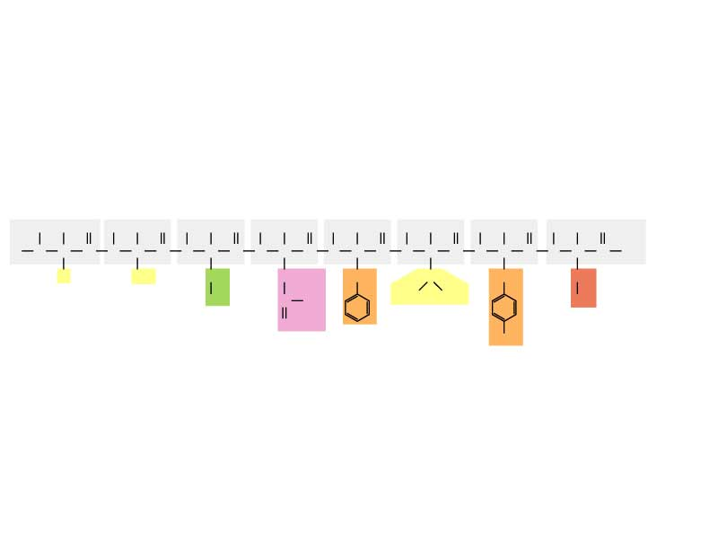
POLYPEPTIDE CHAIN
N-terminus
C-terminus
H
H
O
H
H
O
H
H
O
H
H
O
H
H
O
H
H
O
H
H
O
H
H
O
H
N
C
C
N
C
C
N
C
C
N
C
C
N
C
C
N
C
C
N
C
C
N
C
C
OH
H
CH₃
CH₂
CH₂
CH₂
CH
CH₂
CH₂
OH
C
OH
H₃C
CH₃
SH
O
OH
Notes:
Figure: 3.9b
Caption:
(b) Amino acids can be linked into long chains by peptide bonds.

Slide 13
Peptide Bonds Link Amino Acids
Form when the acid group (COOH) of one amino acid joins with the amine group (NH₂) of a second amino acid
Formed through condensation
Broken through hydrolysis

Slide 14
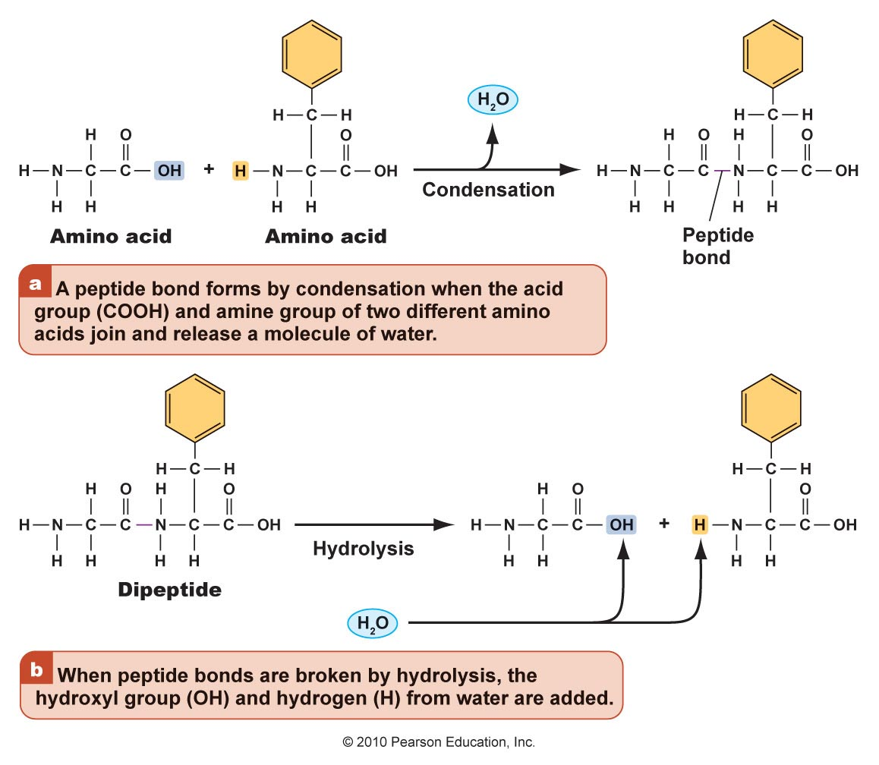
Condensation and Hydrolytic Reactions
Figure 6.3

Slide 15
SAATNYA SENAM

Slide 16
Essential, Nonessential, and Conditional
Essential – must be consumed in the diet
Nonessential – can be synthesized in the body
Conditionally essential – cannot be synthesized due to illness or lack of necessary precursors
Premature infants lack sufficient enzymes needed to create arginine
Notes:
Asam amino kondisional merupakan asam amino yang sama sekali tidak esssensial dan diproduksi dengan sendirinya oleh tubuh ketika seseorang sedang dalam kondiisi sakit, Stres berkepoanjangan atau depresi berat. Asam amino kondisional muncul sebagai pertahanan tubuh agar tubuh tidak mudah dikendalikan serangan bakteri atau virus ketika dalam kondisi yang labil. Asam amino kondisional meliputi tyrosine, prolin, Serin, Sistein, Ornithin arginin, Gliserin dan glutamin. (Baca Juga: Akibat Kelebihan dan Kekurangan Asam Amino)
Asam amino non essensial merupakan senyawa yang ada didalam tubuh yang selalu tersedia dengan sendirinya dan alami yang diproses melalui organ hati, Yaitu meliputi asam alanin, asparagin, Asam aspartat, Asam glutamat.
Asam amino essensial merupakan asam amino yang sangat dibutuhkan tubuh, Mengingat tubuh tidak memiliki kemampuan untuk memproduksi sendiri asam amino essensial. Asam amino essensial hanya bisa didapat dari makanan yang kita konsumsi sehari hari.

Slide 17
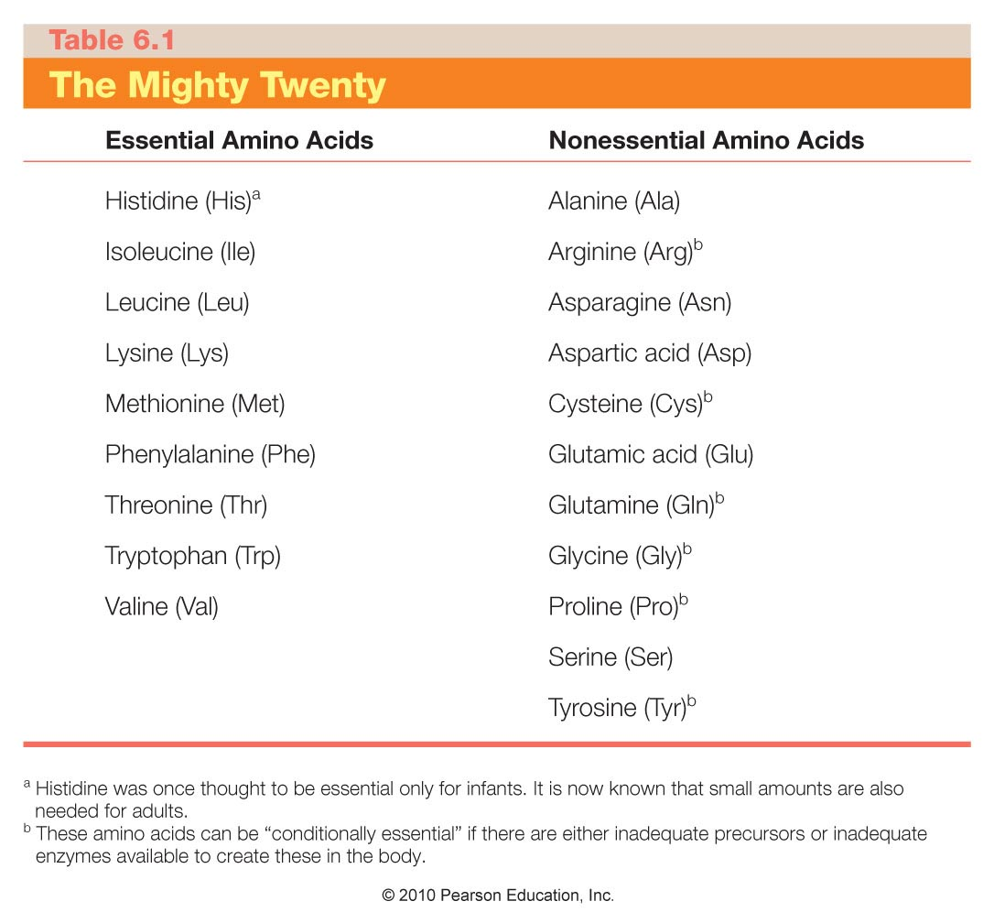

Slide 18
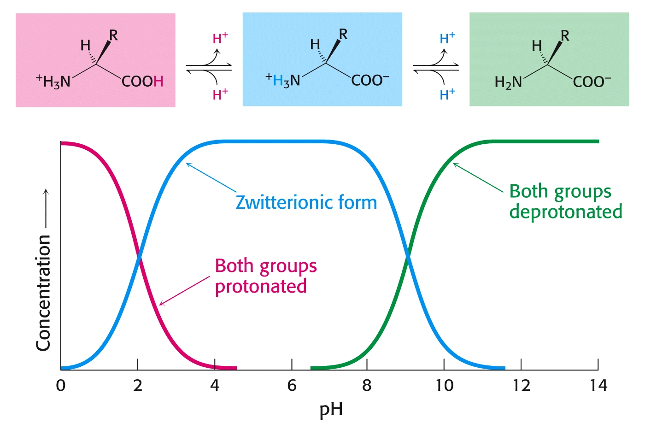
Even though both acids and amines are present in the same molecule, they mostly behave as though they were separate entities:

Slide 19
At low pH, proton concentration [H+]is high. Therefore, both amines and carboxylic acids are protonated. (-NH₃⁺ & -COOH)
At high pH, proton concentration is low. Therefore, both amines and carboxylic acids are deprotonated. (-NH₂ & -COO⁻)
At neutral pH, amines are protonated(-NH₃⁺) and carboxylates are deprotonated(-COO⁻)

Slide 20
“Zwitter” Ions:
Ions bearing two charges were named zwitter ions by German scientists; the name still applies today, especially for amino acids at neutral pH:
⁺H₃N – CH₂ – COO⁻

Slide 21
Acid-Base Properties of Amino Acids
Draw the following chemical structures for glycine:
(Non-existent form:) H₂N – CH₂ - COOH
pH=1: ⁺H₃N – CH₂ - COOH
pH=7: ⁺H₃N – CH₂ – COO⁻
pH=12: H₂N – CH₂ – COO⁻

Slide 22
Low pH Neutral pH High pH

Slide 23
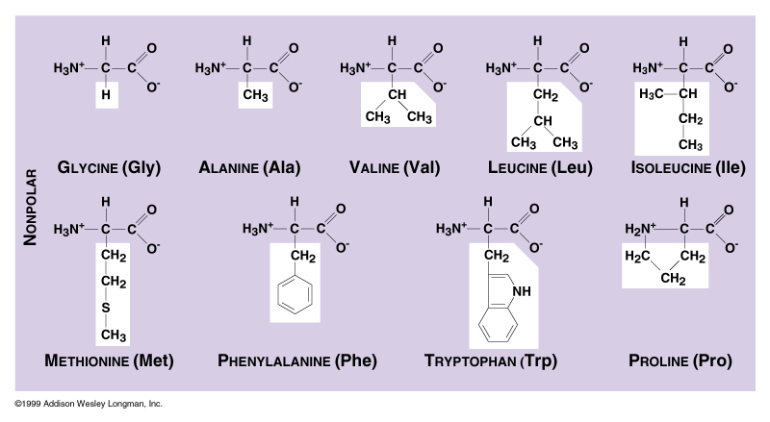

Slide 24
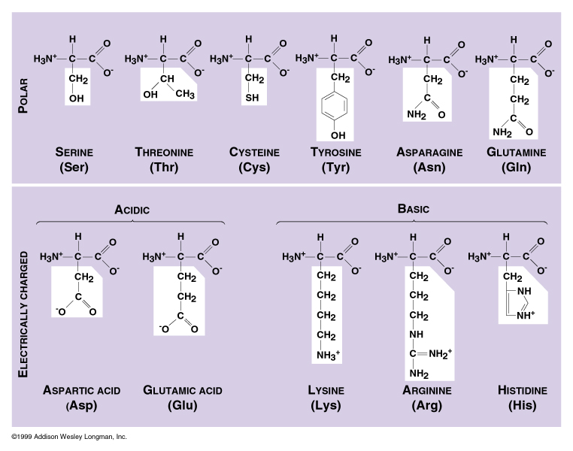

Slide 25
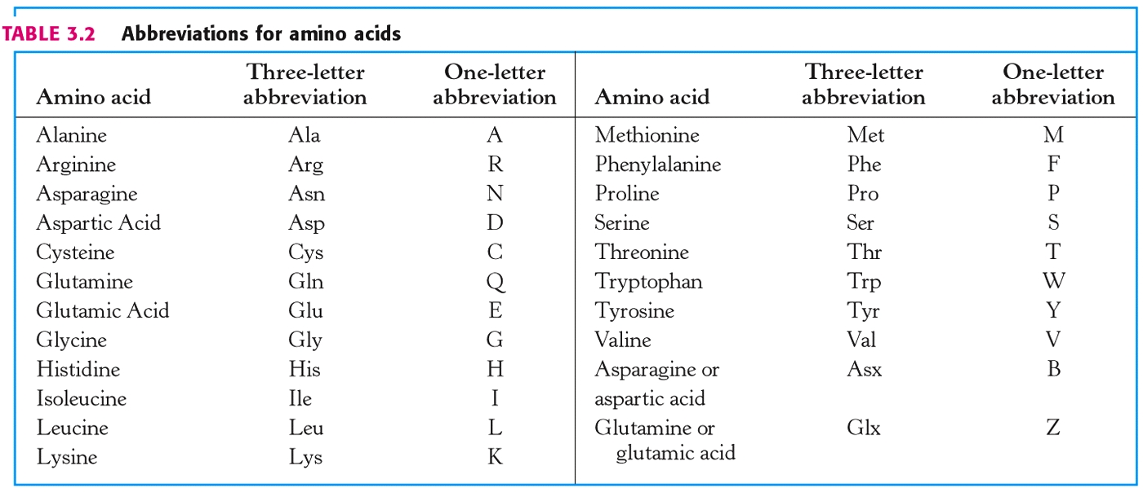

Slide 26
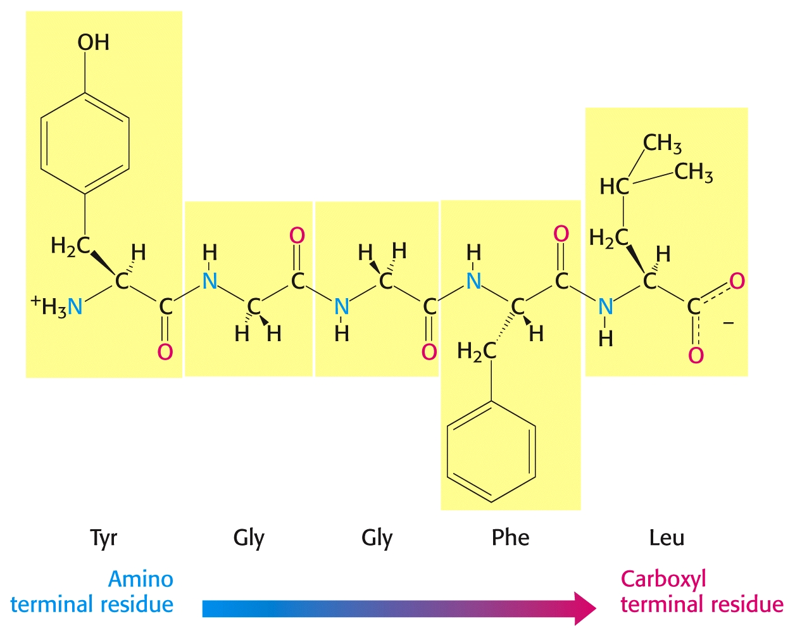

Slide 27
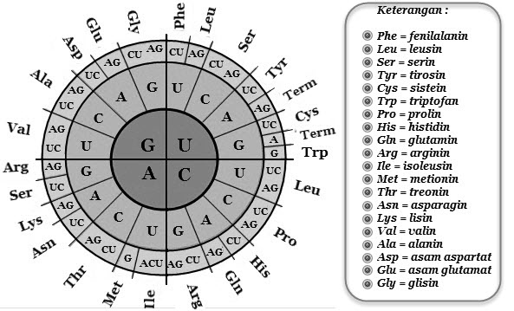

Slide 28
Structure of the Protein
Four levels of structure
Primary structure
Secondary structure
Tertiary structure
Quaternary structure
Any alteration in the structure or sequencing changes the shape and function of the protein
Notes:
Setiap perubahan dalam struktur atau sekuensing mengubah bentuk dan fungsi protein

Slide 29
Notes:
Struktur primer merupakan struktur yang sederhana dengan urutan-urutan asam amino yang tersusun secara linear yang mirip seperti tatanan huruf dalam sebuah kata dan tidak terjadi percabangan rantai (Gambar 4). Struktur primer terbentuk melalui ikatan antara gugus α–amino dengan gugus α–karboksil (Gambar 3). Ikatan tersebut dinamakan ikatan peptida atau ikatan amida (Berg et al., 2006; Lodish et al., 2003). Struktur ini dapat menentukan urutan suatu asam amino dari suatu polipeptida (Voet & Judith, 2009)

Slide 30
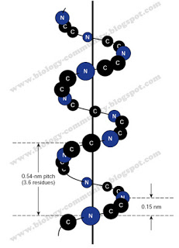
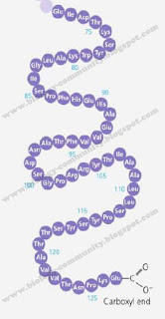
Notes:
Struktur sekunder merupakan kombinasi antara struktur primer yang linear distabilkan oleh ikatan hidrogen antara gugus =CO dan =NH di sepanjang tulang belakang polipeptida. Salah satu contoh struktur sekunder adalah α-heliks dan β-pleated (Gambar 5 dan 6). Struktur ini memiliki segmen-segmen dalam polipeptida yang terlilit atau terlipat secara berulang. (Campbell et al., 2009; Conn, 2008).
Struktur α-heliks terbentuk antara masing-masing atom oksigen karbonil pada suatu ikatan peptida dengan hidrogen yang melekat ke gugus amida pada suatu ikatan peptida empat residu asam amino di sepanjang rantai polipeptida (Murray et al, 2009).

Slide 31
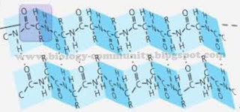
Notes:
Pada struktur sekunder β-pleated terbentuk melalui ikatan hidrogen antara daerah linear rantai polipeptida. β-pleated ditemukan dua macam bentuk, yakni antipararel dan pararel (Gambar 7 dan 8). Keduanya berbeda dalam hal pola ikatan hidrogennya. Pada bentuk konformasi antipararel memiliki konformasi ikatan sebesar 7 Å, sementara konformasi pada bentuk pararel lebih pendek yaitu 6,5 Å (Lehninger et al, 2004). Jika ikatan hidrogen ini dapat terbentuk antara dua rantai polipeptida yang terpisah atau antara dua daerah pada sebuah rantai tunggal yang melipat sendiri yang melibatkan empat struktur asam amino, maka dikenal dengan istilah β turn yang ditunjukkan dalam Gambar 9 (Murray et al, 2009).

Slide 32
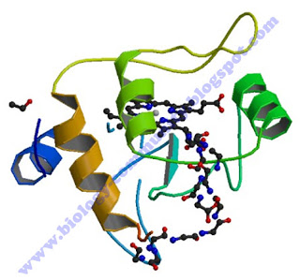
Notes:
Struktur tersier dari suatu protein adalah lapisan yang tumpang tindih di atas pola struktur sekunder yang terdiri atas pemutarbalikan tak beraturan dari ikatan antara rantai samping (gugus R) berbagai asam amino (Gambar 10). Struktur ini merupakan konformasi tiga dimensi yang mengacu pada hubungan spasial antar struktur sekunder. Struktur ini distabilkan oleh empat macam ikatan, yakni ikatan hidrogen, ikatan ionik, ikatan kovalen, dan ikatan hidrofobik. Dalam struktur ini, ikatan hidrofobik sangat penting bagi protein. Asam amino yang memiliki sifat hidrofobik akan berikatan di bagian dalam protein globuler yang tidak berikatan dengan air, sementara asam amino yang bersifat hodrofilik secara umum akan berada di sisi permukaan luar yang berikatan dengan air di sekelilingnya (Murray et al, 2009; Lehninger et al, 2004).

Slide 33
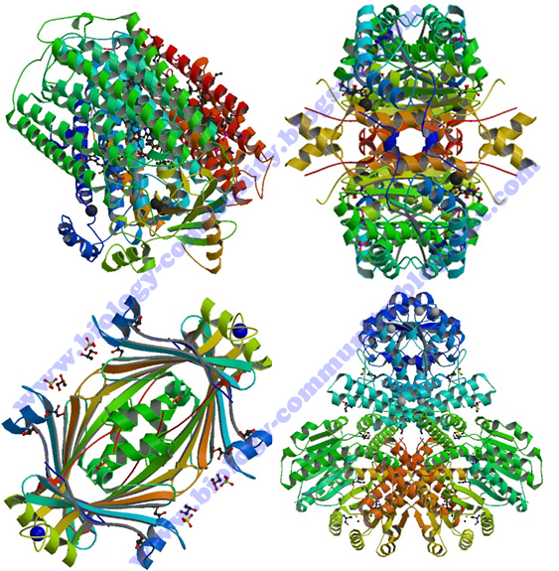
Notes:
Struktur kuarterner adalah gambaran dari pengaturan sub-unit atau promoter protein dalam ruang. Struktur ini memiliki dua atau lebih dari sub-unit protein dengan struktur tersier yang akan membentuk protein kompleks yang fungsional. ikatan yang berperan dalam struktur ini adalah ikatan nonkovalen, yakni interaksi elektrostatis, hidrogen, dan hidrofobik. Protein dengan struktur kuarterner sering disebut juga dengan protein multimerik. Jika protein yang tersusun dari dua sub-unit disebut dengan protein dimerik dan jika tersusun dari empat sub-unit disebut dengan protein tetramerik (Gambar 11) (Lodish et al., 2003; Murray et al, 2009).

Slide 34
Denaturing
Alteration of the protein’s shape and thus functions through the use of
Heat
Acids
Bases
Salts
Mechanical agitation
Primary structure is unchanged by denaturing
Notes:
Agitasi : pengadukan

Slide 35
Denaturing a Protein
Figure 6.5

Slide 36
SAATNYA MAJU KEDEPAN MERINGKAS APA YANG TELAH SAYA SAMPAIKAN 2 MAHASISWA

Slide 37
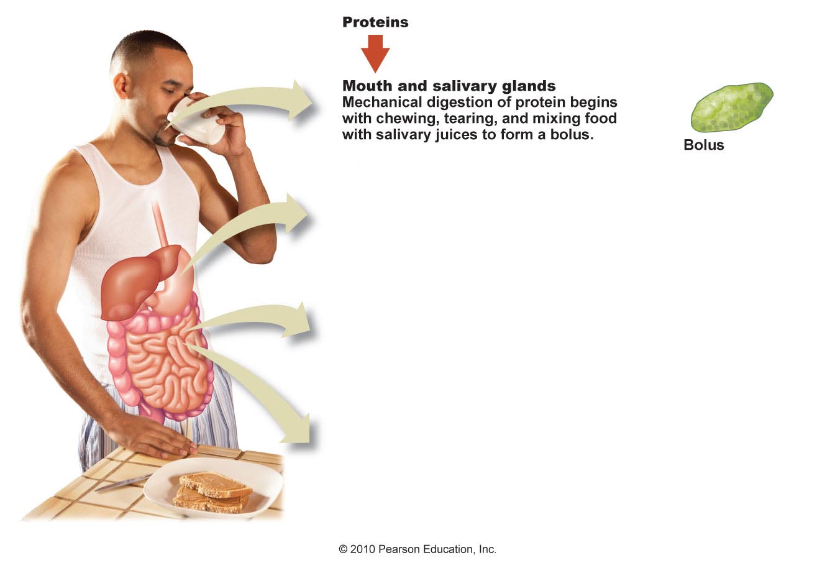
Protein Digestion: Part 1
Figure 6.6

Slide 38
Protein Digestion: Part 2
Figure 6.6

Slide 39
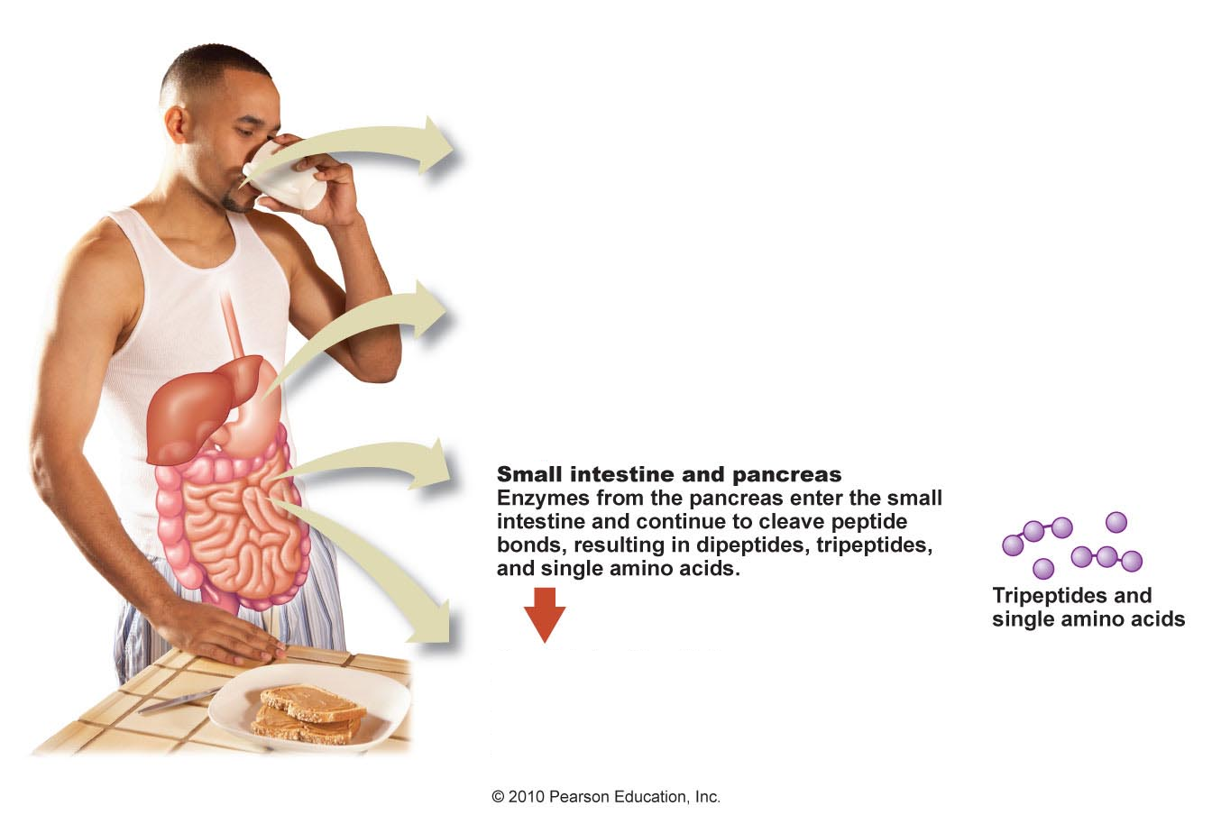
Protein Digestion: Part 3
Figure 6.6

Slide 40
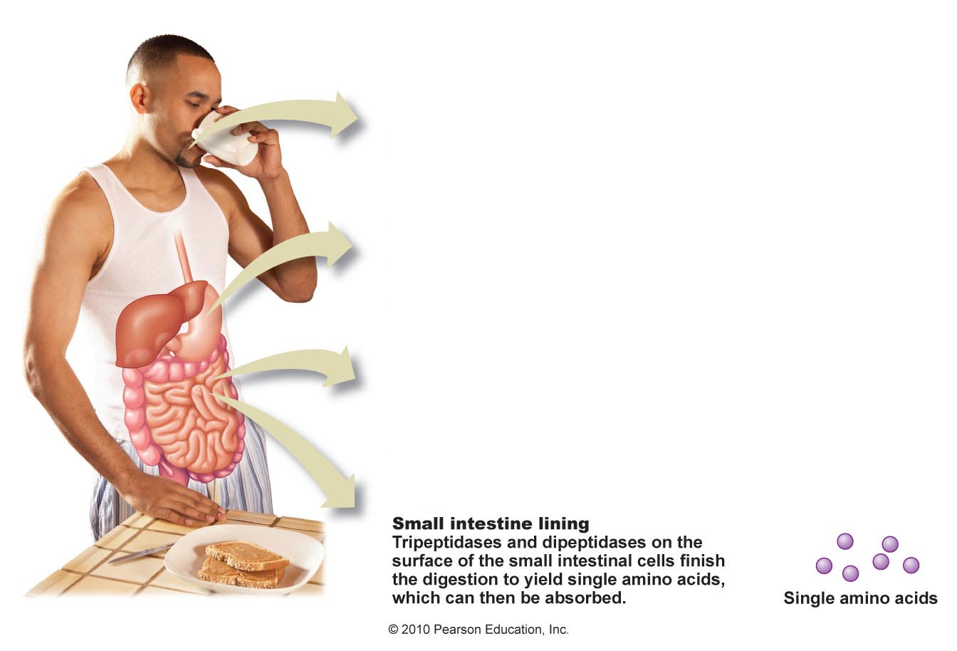
Protein Digestion: Part 4
Figure 6.6

Slide 41
Amino Acid Absorption
Amino acids are absorbed in the small intestine
Amino acids are transported to the liver from the intestines via the portal vein
In the liver, amino acids are
Used to synthesize new proteins
Converted to energy, glucose, or fat
Released to the bloodstream and transported to cells throughout the body
Occasionally proteins are absorbed intact

Slide 42
Amino Acid Metabolism
Liver metabolizes amino acids, depending on bodily needs
Most amino acids are sent into the blood to be picked up and used by the cells
Amino acid pool is limited but has many uses
Protein turnover – the continual degradation and synthesizing of protein

Slide 43
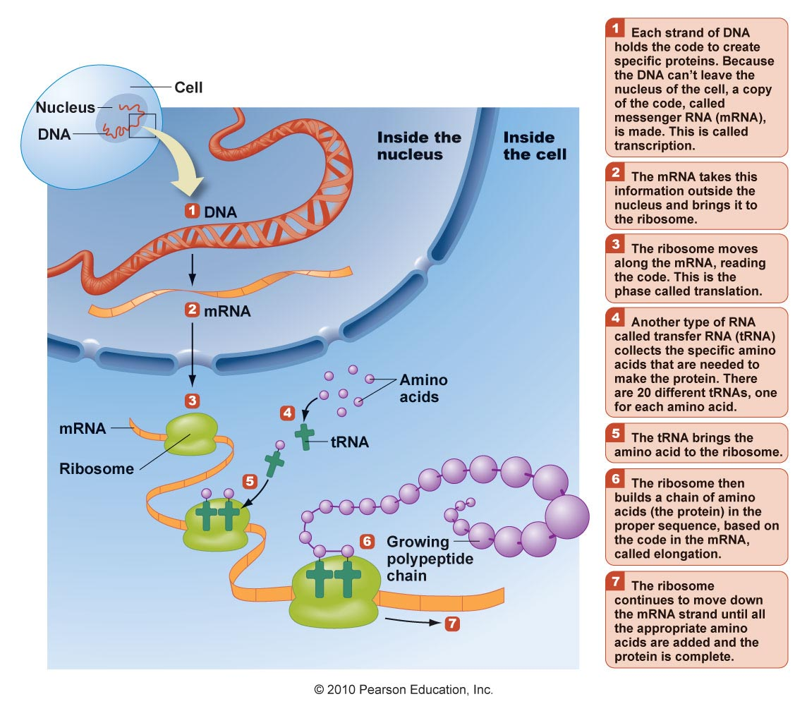

Slide 44
transcription
translation
DNA
RNA
Protein

Slide 45
Deamination
When the amino acid pool reaches capacity the amino acids are broken down to their component parts for other uses
First deamination must occur
Carbon-containing remnants are
Converted to glucose, if they are glucogenic amino acids, through gluconeogensis
Converted to fatty acids and stored as triglycerides in adipose tissue

Slide 46
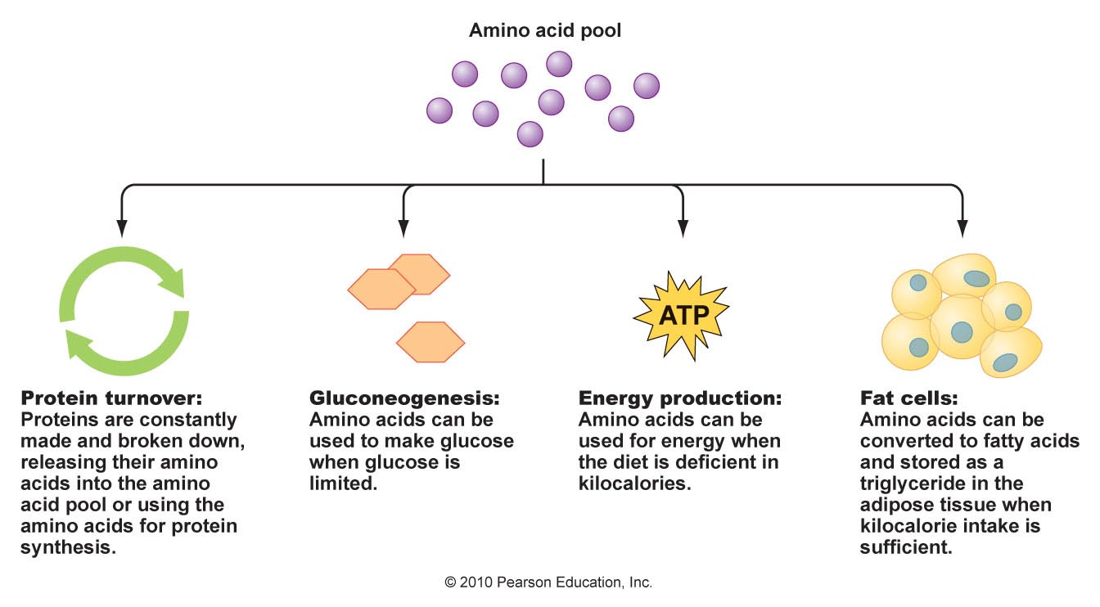
Metabolic Fate of Amino Acids

Slide 47
How Does the Body Use Protein?
Functions of protein
Provide structural and mechanical support
Maintain body tissues
Functions as enzymes and hormones
Help maintain acid base balance
Transport nutrients
Assist the immune system
Serve as a source of energy when necessary

Slide 49
How Much Protein Do You Need?
Healthy, nonpregnant adults
Should consume enough to replace what is used every day
The goal is nitrogen balance
Pregnant woman, people recovering from surgery or injury, and growing children
Should consume enough to build new tissue

Slide 50
Nitrogen Balance and Imbalance
Figure 6.12

Slide 51
Not All Protein Is Created Equal
High quality protein
Is digestible
Contains all essential amino acids
Provides sufficient protein to synthesize nonessential amino acids
It helps to be aware of:
Amino acid score
Limiting protein
Protein digestibility corrected amino acid score (PDCAAS)
Biological value of protein rates absorption and retention of protein for use

Slide 52
Protein Quality
Complete proteins
Contain all nine essential amino acids
Usually animal source are complete proteins
Are considered higher quality
Incomplete proteins
Low in one or more essential amino acid
Usually plant sources are incomplete

Slide 53
Protein Needs
Protein intake recommendations
10–35% of total daily kilocalories
Adults over 18
0.8 g/kg daily
American College of Sports Medicine, the American Dietetic Association, and other experts advocate
50–100% more protein for competitive athletes participating in endurance exercise or resistance exercise
Typically this population eats more and therefore gets additional protein

Slide 54
Best Sources of Protein
Proteins are abundant in
Dairy foods
Meats
Poultry
Meat alternatives such as dried beans, peanut butter, nuts, and soy
3 oz serving of cooked meat, poultry, or fish
Provides 21–25 grams of protein
About 7 g/oz
About the size of a deck of cards
Adequate amount for one meal

Slide 55
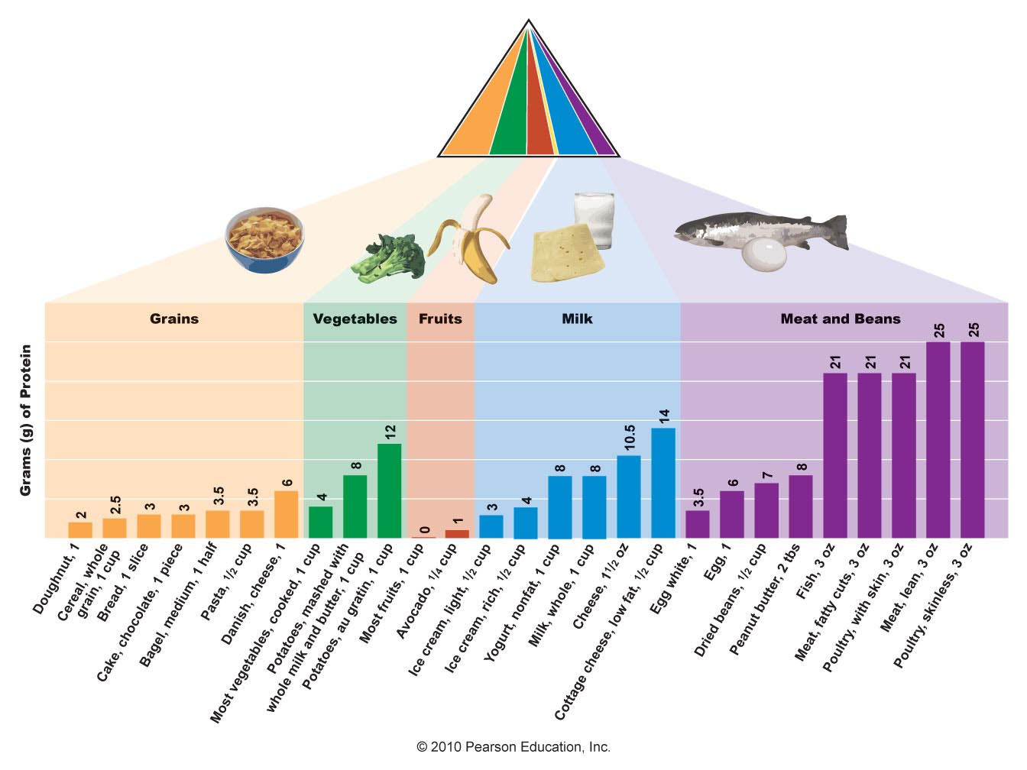
Best Sources of Protein
Figure 6.14

Slide 56
Protein Bars
Are marketed as convenient and portable
Can be
High in saturated fat and/or sugar
Low in fiber
Expensive
A peanut butter sandwich is portable and lower in saturated fat and sugar and higher in fiber than some protein bars

Slide 57
Eating Too Much Protein
Risk of heart disease
Risk of kidney stones
Risk of calcium loss from bones
Risk of colon cancer
Displacement of other nutrient-rich, disease preventing foods

Slide 58
Eating Too Little Protein
Protein-energy malnutrition (PEM)
Protein is used for energy rather than its other functions in the body
Other important nutrients are in short supply
More prevalent in infants and children
17,000 children die each day as a result

Slide 59
Too Little Protein
Without adequate protein
Cells lining the GI tract are not sufficiently replaced as they slough off
Digestive function is inhibited
Absorption of food is reduced
Intestinal bacteria gets into the blood and causes septicemia
Immune system is compromised due to malnutrition and cannot fight infection

Slide 60
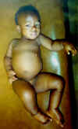
Types of PEM: Kwashiorkor
Severe protein deficiency
Generally result of a diet high in grains and deficient in protein
Symptoms range from
Edema in legs, feet, and stomach
Muscle tone and strength diminish
Hair is brittle and easy to pull out
Appear pale, sad, and apathetic
Prone to infection, rapid heart rate, excess fluid in lungs, pneumonia, septicemia, and water and electrolyte imbalances
(Image from http://www.thachers.org/pediatrics.htm)
Figure 6.16
Notes:
Protein Mal Energy Mal nuitrition

Slide 61
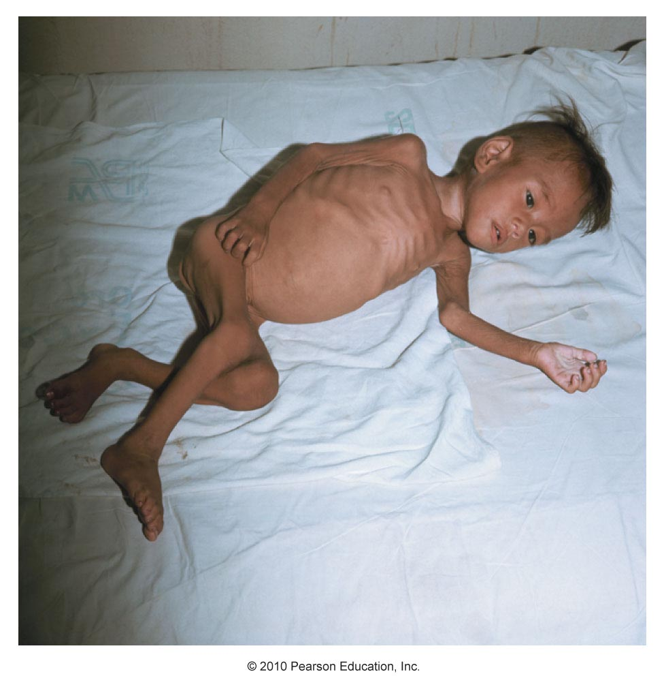
Types of PEM: Marasmus
Results from a severe deficiency in kilocalories
Frail, emaciated appearance
Weakened and appear apathetic
Many cannot stand without support
Look old
Hair is thin, dry, and lacks sheen
Body temperature and blood pressure are low
Prone to dehydration, infections, and unnecessary blood clotting
Figure 6.17

Slide 62
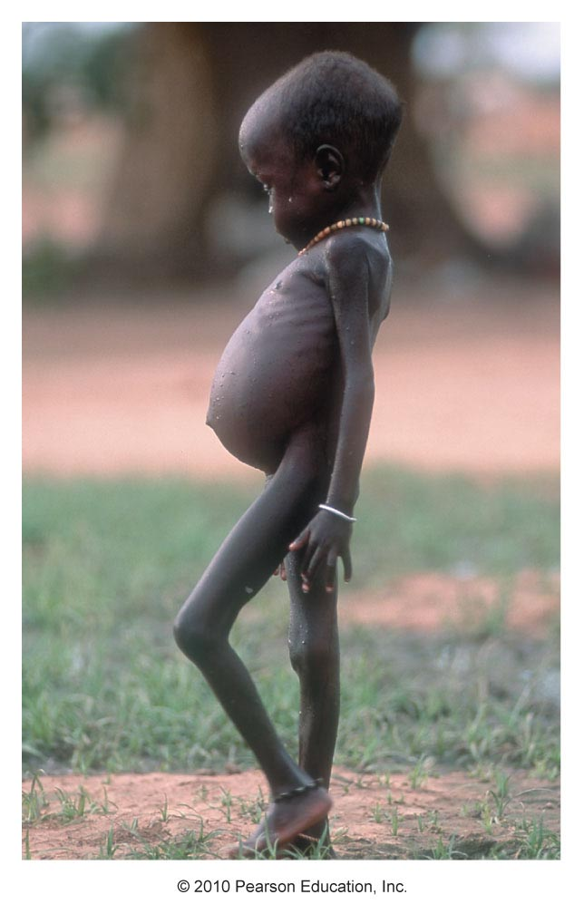
Types of PEM: Marasmic Kwashiorkor
Chronic deficiency in kilocalories and protein
Have edema in legs and arms
Have a “skin and bones” appearance
With treatment the edema subsides and appearance becomes more like someone with marasmus

Slide 63
Treatment for PEM
Medical and nutritional treatment can dramatically reduce mortality rate
Should be carefully and slowly implemented
Step 1 – Address life-threatening factors
Severe dehydration
Fluid and nutrient imbalances
Step 2 – Restore depleted tissue
Gradually provide nutritionally dense kilocalories and high-quality protein
Step 3 – Transition to foods and introduce physical activity

Slide 64
Vegetarian Diet
People choose vegetarian diets for a variety of reasons
Ethical
Religious
Environmental
Health
Vegetarians must consume adequate amounts of a variety of food and should plan meals well

Slide 66
Potential Benefits, Risks of a Vegetarian Diet
Benefits of a healthy vegetarian diet
Reduced risk of
Heart disease
High blood pressure
Diabetes
Potential risks of a vegetarian diet
Underconsumption of certain nutrients
Protein
Vitamin B₁₂
Cancer
Stroke
Obesity

Slide 67
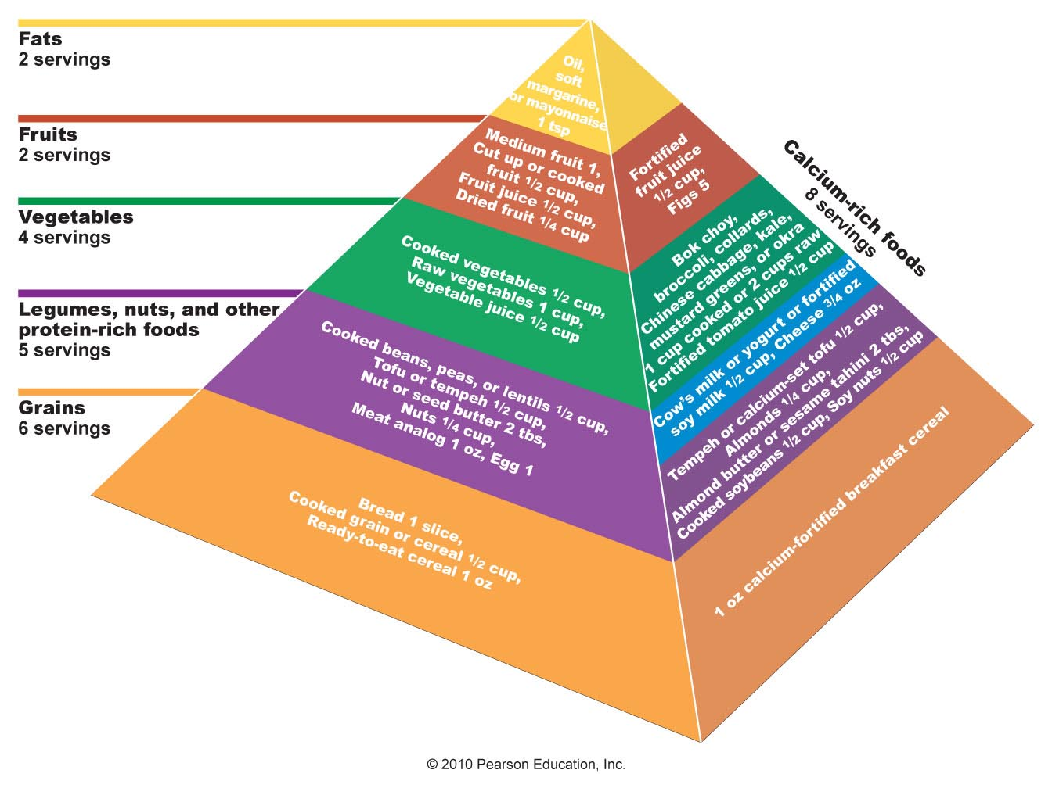
Vegetarian Food Guide Pyramid
Figure 6.18

Slide 68
Putting It All Together
Majority of daily kilocalories should come from carbohydrate-rich foods
Fat intake should be no more than about one-third of daily kilocalories
Protein should provide the rest of the daily kilocalories

Slide 69
Putting It All Together
Best plan for a healthful diet
Eat an abundance of
Grains (at least ½ whole grains)
Vegetables
Fruits
Eat modest amounts of
Commercially made bakery and snack items
Vegetables with creamy sauces or added butter
Sweets
Choose low-fat dairy products, lean meat, poultry, and fish to minimize the intake of heart-unhealthy saturated fats

Slide 70
TERIMA KASIH

