Slide 1
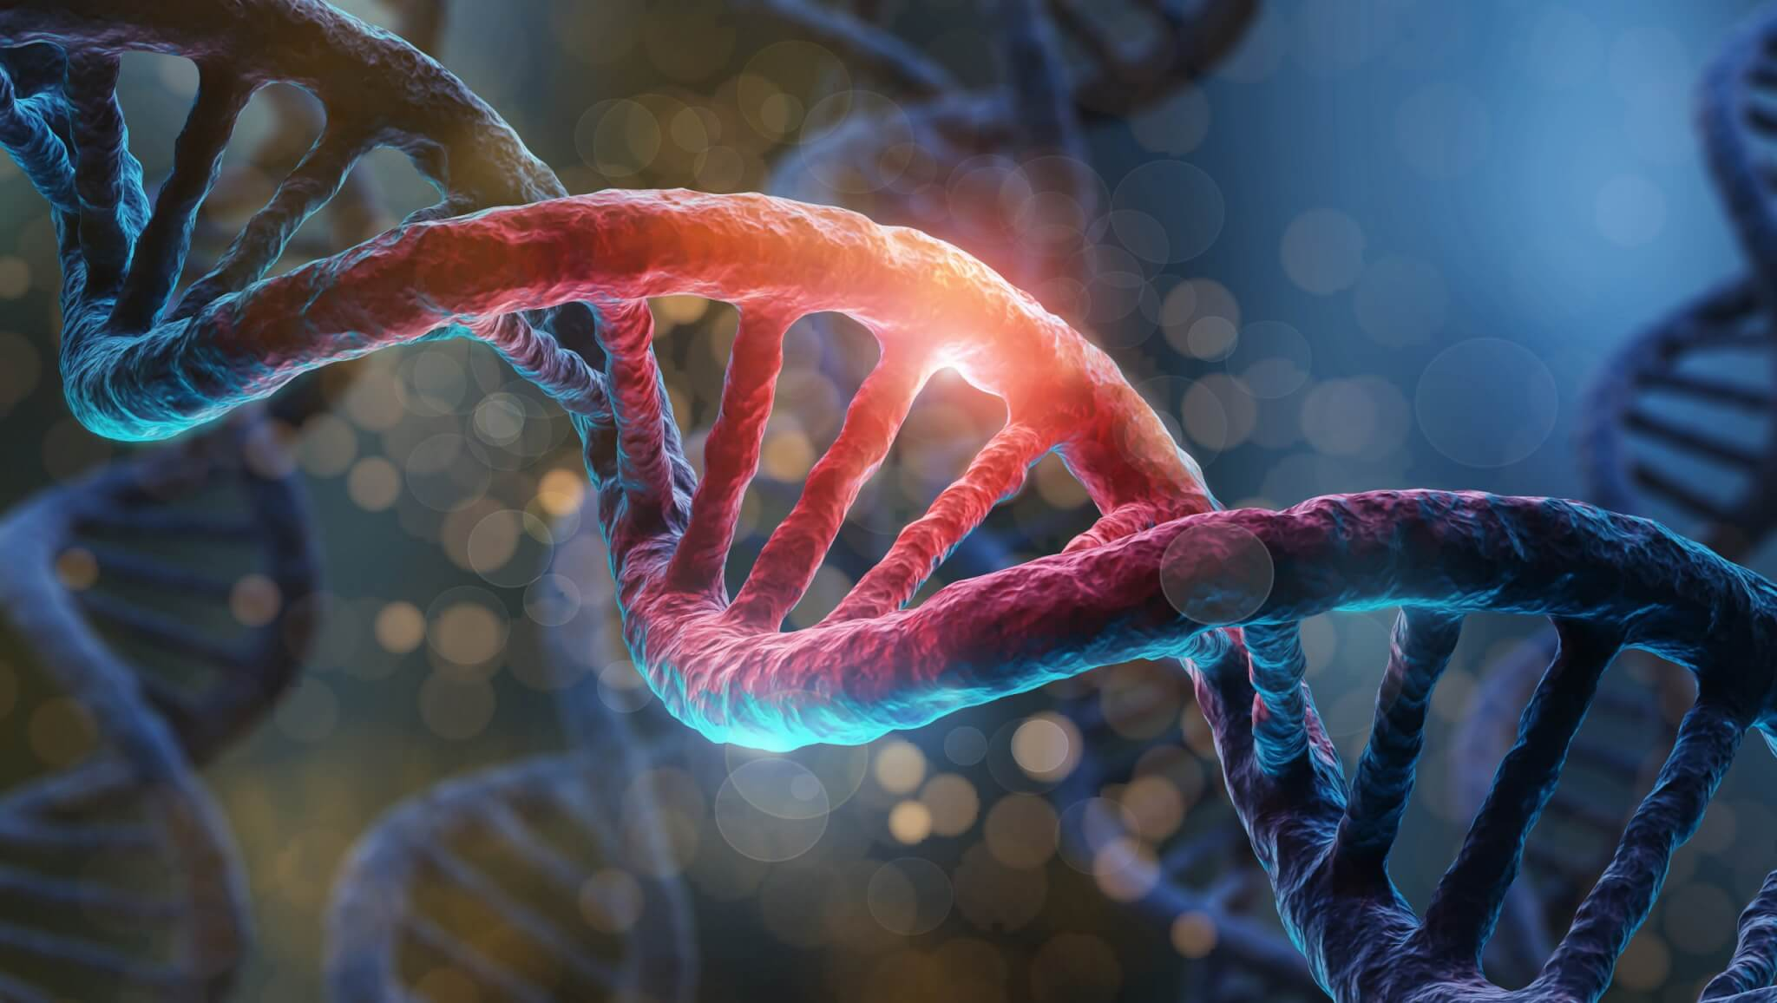
Introduction of Basic SCIENCE OF NURSING
Diyah Candra anita

Slide 2
Basic nursing of science
This course learns about nursing procedures which are the scientific basis in nursing practice covers the basic concepts of pathology and pathophysiology, infectious agents, genetics and cell mutation, blood clotting, medical physics in supporting examinations, fluid and electrolyte balance, and related lifestyle with disease.
The learning experience that will be carried out by students includes learning in class and practicum in the classroom laboratory.

Slide 3
Credit and evaluation of BNS©
Laboratory activities
Project results
Quizzes
Mid examination
Last examination
Lecture attendance
Evaluation of this course
20%
20%
10%
20%
20%
10%
3 sks
theory
21 meetings
1 sks
Laboratory activities
14 meetings

Slide 4
Material of study [1]
The basic concepts of pathology and pathophysiology, including adaptation, injury, and cell aging; congenital abnormalities; cell growth and differentiation; inflammatory response.
The concept of infectious agents, including viruses, bacteria, fungi, parasites, rickettsia, chlamydia; factors affecting the transmission of infectious agents; differences in the infectious process of various infectious agents; condition which weakens the host's defenses against microorganisms; opportunistic infections; controlling growth of microorganisms; and how to reduce the number of contaminating microorganisms and prevent transmission.
The concept of genetics, including the function of chromosomes in humans; cell cycle; mitotic division and meiosis; DNA structure; central dogma DNA-RNA-protein; gene expression; genetic disorders; and genetic variation in individuals and populations.

Slide 5
Material of study [2]
The concept of cell mutation, including the notion of mutation; cause of mutation; various mutations; process mutation; mutant formation; and changes due to mutations.
The concept of blood clotting which includes the mechanism of blood clotting; extrinsic pathway; intrinsic pathways; common pathways; the role of vitamin K in clotting; hemostatic control mechanisms; and intravascular clotting.
The concept of the importance of anatomical pathology examination (biopsy); clinical pathology (hematologic, arterial gas, feces, and urine); DNA testing; radiological examination; as well as physical examinations such as blood pressure, visual acuity, muscle strength.
The concept of fluid and electrolyte balance, which includes the physiology of body fluids; distribution and composition of body fluids; fluid and electrolyte balance mechanisms; body fluid regulation system; and buffer system, shock.
The concept of a lifestyle that can affect health, including the influence of smoking, alcohol, drugs, radiation to the body; obesity and metabolic syndrome as causes of premature aging.

Slide 6
Laboratory Activities
Microscope
Microbiology
Meiosis and mitosis
Genetics and Mendel's laws
Blood pressure and bioacoustics checks
Bio optic examination: visual acuity and color blindness
Biothermal and biomechanical examination
Check the erythrocyte sedimentation rate and Hb sahli
Blood group examination: ABO and rhesus
Checking blood sugar, cholesterol, and uric acid
Case Discussion I
Case Discussion II
Practical exam I
Practical exam I

Slide 7
references
MAIN References
ADDITION References
Anita, DC., Suwono, Asnindari, LN. (2022). Praktikum Sains Keperawatan. Yogyakarta: Deepublish.
Porth, C., & Matfin, G. (2009). Pathophysiology: Concepts of altered health states (8th ed.). Wolters Kluwer Health/Lippincott Williams & Wilkins.
Nair, M., & Peate, I. (2015). Pathophysiology for Nurses at a Glance (1st ed.) Willey and sons.
Ibrahim, F. & Welday, M. (2008). LECTURE NOTES. Undergraduate Nursing Students. Pathophysiology. Haramaya
Bruyere, Harold J. (2009). 100 Case Studies in Pathophysiology. Lippincott Williams&Wilkins, United States of America. ISBN 9780781761451.
Porth, C., & Kunert, M. P. (2014). Pathophysiology: concepts of altered health states (9th ed.). Chicago / Turabian
Mohan, H. (2010). Textbook of pathology (7th ed.) Jaypee Brothers Medical Publishers (P) Ltd.
Suyanto. (2016). Patologi. Kementrian Kesehatan RI.
Bezabeh, M., Tesfaye, A., Ergicho, B., Erke, M., Mengistu, S., Bedane, A., Desta, A. (2004). Lecture Notes for Health Science students: General Pathology. USAID.

Slide 8
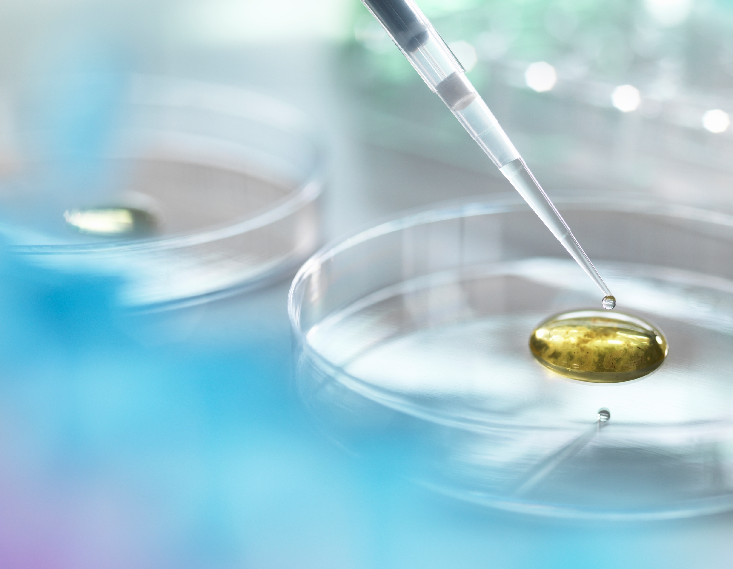
Basic concept in pathophysiology and pathology

Slide 9
Understanding cells
The cell is the body’s basic building block.
It’s the smallest living component of an organism.
Many organisms are made up of one independent, microscopically tiny cell.
Other organisms, such as humans, consist of millions of cells grouped into highly specialized units that function together throughout the organism’s life.
Large groups of individual cells form tissues, such as muscle, blood, and bone.
Tissues form the organs (such as the brain, heart, and liver), which are integrated into body systems (such as the central nervous system [CNS], cardiovascular system, and digestive system).

Slide 10
Cell components
Cells are composed of various structures, or organelles, each with specific functions
The organelles are contained in the cytoplasm—an aqueous mass—that’s surrounded by the cell membrane.
The largest organelle, the nucleus, controls cell activity and stores deoxyribonucleic acid (DNA), which carries genetic material and is responsible for cellular reproduction or division
More components :
Adenosine triphosphate, the energy that fuels cellular activity, is made by the mitochondria.
Ribosomes and the endoplasmic reticulum synthesize proteins and metabolize fat within the cell.
The Golgi apparatus holds enzyme systems that assist in completing the cell’s metabolic functions.
Lysosomes contain enzymes that allow cytoplasmic digestion to be completed.

Slide 11
Cell division and reproduction
Before division, a cell must double its mass and content → This occurs during the growth phase, called interphase → Chromatin, the small, slender rods of the nucleus that give it its granular appearance, begins to form.
Replication and duplication of DNA occur during the four phases of mitosis:
Prophase, metaphase, anaphase, telophase
Cell reproduction occurs in two stages.
In the first stage, called mitosis, the nucleus and genetic material divide.
In the second stage, called cytokinesis, the cytoplasm divides, beginning during late anaphase or telophase. At the end of cytokinesis, the cell produces two daughter cells
Notes:
Individual cells don’t live as long as the organism they’re a part of. They’re subject to wear and tear and must reproduce and be replaced. Most cells reproduce as quickly as they die.

Slide 12
Replicate and divide
Prophase
The chromosomes coil and shorten, and the nuclear membrane dissolves.
A centromere.
Metaphase
The centromeres then align themselves in the middle of the spindle.
Anaphase
The centromeres begin to separate
46 chromosomes are present
Telophase
A new membrane forms around each set of 46 chromosomes
Cytokinesis occurs, and the cytoplasm divides,
Producing two identical new daughter cells.

Slide 13
Pathophysiology versus pathology
While both terms denote the study of disease
The term pathology is a broader term dealing with all aspects of disease.
This study is valuable for doctors or pathologists who are also interested in macro and microscopic characteristics of tissues and organs.
The term pathophysiology the focus is on abnormal mal function of diseased organs, with applications for diagnostic procedures leading to patient care.
Health care professionals have more to do with pathophysiology when dealing with patients

Slide 14
Pathophysiology
Pathophysiology is the study of the disturbance of normal mechanical, physical, and biochemical functions, either caused by a disease, or resulting from a disease or abnormal syndrome or condition that may not qualify to be called a disease.
An alternate definition is "the study of the biological and physical manifestations of disease as they correlate with the underlying abnormalities and physiological disturbances”

Slide 15
“House of Medicine“
Neurology
Gynekology and Obtetrics
Surgery
Internal medicine
Ceiling plate
P A T H O P H Y S I O L O G Y
Pathology
Pharmacology
Microbiology
walls
P H Y S I O L O G Y
Base plate
Anat
Biol
Histol
Bioch
Chem
Biophys
Foundations

Slide 16
Structure of pathophysiology
1. General pathophysiology
2. Special /organs, systems/ pathophysiology
General pathophysiology – content
It deals with general pathologic processes, and
pathomechanisms: -thay are involved in pathogenesis of more than one disease. It also contain explanation of some basic medical terms
Examples of general pathological processes –
inflammation, fever, hyperthermia, hypothermia, shock,
stress, edemas, disturbances of control mechanisms,
hyperreactivity, hyporeactivity, damage of genetic
information....

Slide 17
2. Special pathophysiology - is devoted to analysis and
explanation of pathomechanisms involved in functional
disturbances of the organs and systems of the organism:
Content of special pathophysiology:
hematologic disorders
disorders of cardiovascular system
dysfunctions of respiratory system
disorders of uropoietic system
neurologic disorders
dysfunctions of of endocrine system
metabolic disorders
disorders of reproductive system
dysfunctions of of GIT

Slide 18
The core aspects of diseases in pathology
The word pathology came from the Latin words “patho” & “logy”.
‘Patho’ means disease and ‘logy’ means study, therefore pathology is a scientific study of disease.
Diseases may, in turn, be defined as an abnormal variation in structure or function of any part of the body.
Pathology gives explanations of a disease by studying the following four aspects of the disease.
Etiology: means the cause of the disease
Pathogenesis: means the mechanism through which the cause operates to produce the pathological and clinical manifestations. The pathogenetic mechanisms could take place in the latent or incubation period. Pathogenesis leads to morphologic changes
Morphologic changes: refer to the structural alterations in cells or tissues that occur following the pathogenetic mechanisms
Functional derangements and clinical significance: The morphologic changes in the organ influence the normal function of the organ. By doing so, they determine the clinical features (symptoms and signs), course, and prognosis of the disease

Slide 19
PROGNOSIS
Prognosis is a prediction of the chance of recovery or survival from a disease.
Most doctors give a prognosis based on statistics of how a disease acts in studies on the general population.
Prognosis can vary depending on several factors, such as the stage of disease at diagnosis, type of disease and even gender for example cancer.
Many factors can influence the prognosis of a patient with cancer.
Among the most important are the type and location of the cancer, the stage of the disease (the extent to which the cancer has spread in the body) and how quickly the cancer is likely to grow and spread.
Other factors that affect prognosis include the biological and genetic properties of the cancer cells (biomarkers), the patient’s age and overall general health, and the extent to which the patient’s cancer responds to treatment

Slide 20
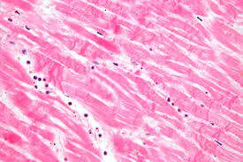
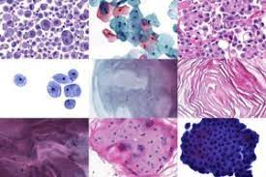
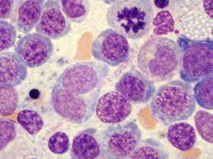
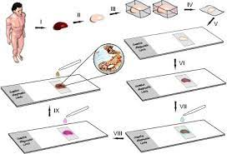
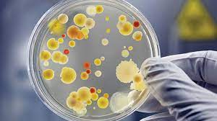
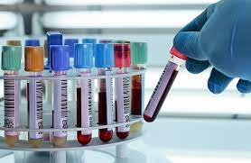
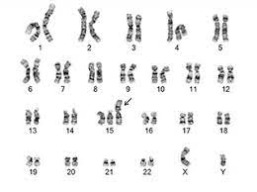
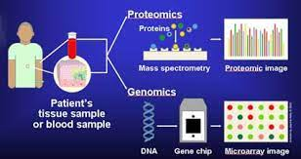
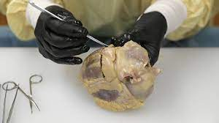
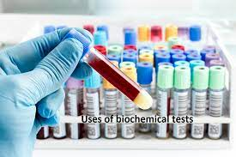
Diagnostic techniques used in pathology
Histopathology
Cytopathology
Hematopathology
Immunohisto-chemistry (IHC)
Microbiological examination
Biochemical examination
Cytogenetics
Molecular techniques
Autopsy

Slide 21
The causes of disease
Physical agents
Chemicals
Nutritional deficiencies & excesses
Infections & infestations
Immunological factors
Psychogenic factors
Diseases can be caused by either environmental factors, genetic factors or a combination of the two.
Environmental causes of disease are many and are classified into
Genetic factors. These are hereditary factors that are inherited genetically from parents

Slide 22
Course of disease (1)
Latency periode
Exposure
Biological onset
Clinical onset
Permanent damage
Death
The course of a disease in the absence of any intervention is called the natural history of the disease.
The different stages in the natural history of disease include:
Exposure to various risk factors (causative agents)
Latency, period between exposure and biological onset of disease
Biological onset of disease; this marks the initiation of the disease process, however, without any sign or symptom. Following biological onset of disease, it may remain asymptomatic or subclinical (i.e. without any clinical manifestations), or may lead to overt clinical disease

Slide 23
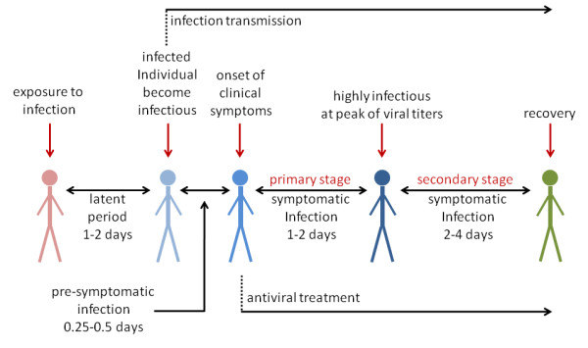
Course of disease (2)
4. Incubation (induction) period refers to variable period of time without any obvious signs or symptoms from the time of exposure.
5. The clinical onset of the disease, when the signs and symptoms of the disease become apparent. The expression of the disease may be variable in severity or in terms of range of manifestations.
6. The onset of permanent damage, and
7. Death
Natural recovery, i.e. recovery without any intervention, can occur at any stage in the progression of the disease.

Slide 24
Stress and disease
When a stressor such as a life change occurs, a person can respond in one of two ways:
by adapting successfully or by failing to adapt.
A maladaptive response to stress may result in disease.
The underlying stressor may be real or perceived.

Slide 25
Outcome and consequences of disease
Resolution can occur leaving no sequelae,
The disease can settle down, but sequelae are left, or
It may result in death

Slide 26
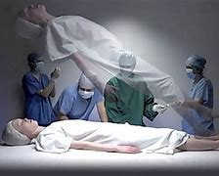
Clinical death
Clinical death is the reversible transmission between life and biologic death.
Clinical death is defined as the period of respiratory, circulatory and brain arrest during which initiation of resuscitation can lead to recovery.
Clinical death begins with either the last agonal inhalation or the last cardiac contraction.
Signs indicating clinical death are:
The patient is without pulse or blood pressure and is completely unresponsive to the most painful stimulus.
The pupils are widely dilated
Some reflex reactions to external stimulation are preserved → For example, during intubations, respiration may be restored in response to stimulation of the receptors of the superior laryngeal nerve, the nucleus of which is located in the medulla oblongata near the respiratory center.
Recovery can occur with resuscitation.

Slide 27
Biological Death
Biological death (sure sign of death), which sets in after clinical death, is an irreversible state of cellular destruction.
It manifests with irreversible cessation of circulatory and respiratory functions, or irreversible cessation of all functions of the entire brain, including brain stem

Slide 28
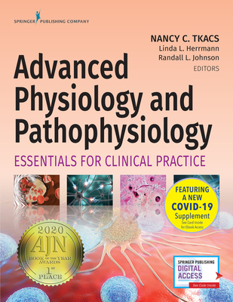
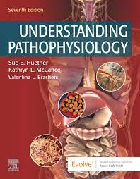
Thank you

