Slide 1
BIO-OPTIK

Slide 2
BIO-OPTIK
Bio (makhluk hidup/ zat hidup) dan optik (cahaya atau berkas sinar)
Fokus utama di biooptik adalah terkait dengan indera penglihatan manusia, yaitu mata

Slide 3
ANALOGI
Sistem optik mata serupa dengan kamera bahkan lebih mahal oleh karena :
Mata bisa mengamati objek dengan sudut yang sangat besar
Tiap mata mempunyai kelopak mata dan ada cairan lubrikasi
Dalam satu detik dapat memfokuskan objek berjarak 20 cm
Mata sangat efektif pada intensitas cahaya 10 : 1
Diafragma mata di atur secara otomatis oleh iris
Bayangan yang terbentuk oleh mata akan diteruskan ke otak.

Slide 4
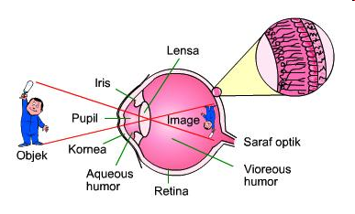
PEMBENTUKAN BAYANGAN PADA MATA
Mata bisa melihat benda jika cahaya yang dipantulkan benda sampai pada mata dengan cukup, kemudian lensa mata akan membentuk bayangan yang bersifat nyata, terbalik dan diperkecil pada retina

Slide 5
VISUS
Nilai kebalikan sudut (dalam menit) terkecil di mana sebuah benda masih dapat dilihat dan dapat dibedakan.
Visus memberi pengertian tentang optik, dan memberi keterangan mengenai baik buruknya fungsi mata secara keseluruhan.

Slide 6
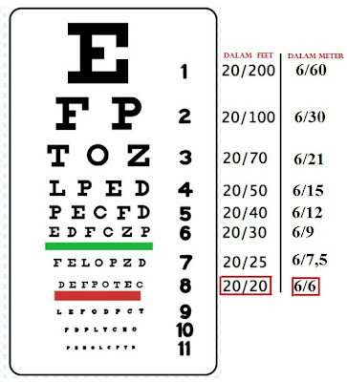
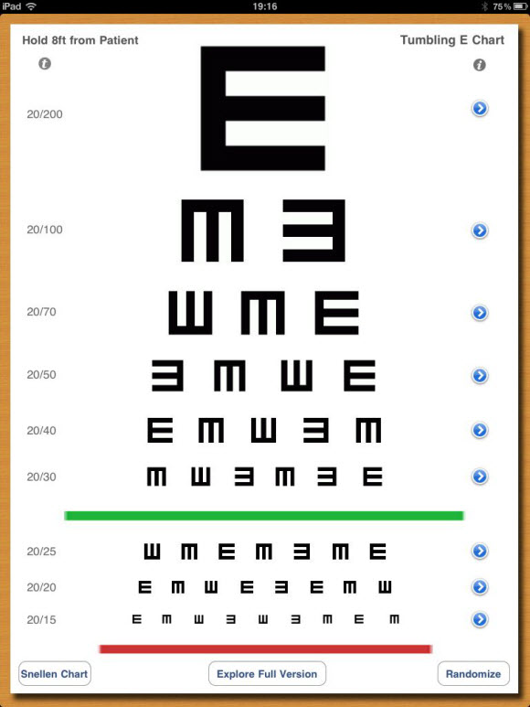
OPTOTYPE SNELLEN

Slide 7
MENGHITUNG VISUS
$$V=\frac{D}{d}$$
Keterangan:
V = Ketajaman Penglihatan (Visus)
D = Jarak yang dilihat oleh mata normal
d = Jarak yang dilihat oleh naracoba

Slide 8
TANGGAP CAHAYA
Bagian mata yang tanggap cahaya adalah retina. Ada dua tipe fotoreseptor :
Rod Cells : Jumlah sel terbanyak, berfungsi untuk penglihatan peripheral dan saat malam, persepsi terhadap cahaya dan kegelapan, gerakan, tidak sensitif terhadap warna
Cone Cells : Berfungsi untuk penglihatan “straight ahead”, persepsi warna dan ketajaman atau detail.

Slide 9
DAYA AKOMODASI
Dalam hal memfokuskan objek pada retina, lensa mata memegang peranan penting. Kemampuan lensa mata untuk memfokuskan objek disebut daya akomodasi
Titik terdekat di mana lensa mata memfokuskan suatu bayangan pada retina disebut titik dekat (punctum proksimum (+ 25 cm)

Slide 10
Daya Akomodasi

Slide 11
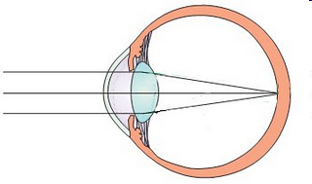
Jenis-jenis Mata & Teknik Koreksi
EMETROP

Slide 12
MYOPIA

Slide 13
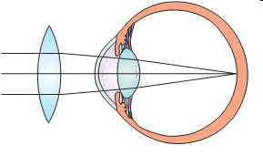
HIPERMETROPIA

Slide 14
ASTIGMATISME

Slide 15
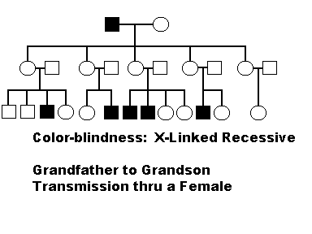
INTRODUCTION TO COLORBLINDNESS
Colorblindness is a defect of vision affecting the ability to distinguish colors,
Occurring mostly in males.
Color blindness is caused by a defect in the retina or in other nerve portions of the eye.
Also known as dichromatism, this disease consists of the inability to differentiate between reds and greens.

Slide 16
What's it Like Being Colorblind?
Most color-blind people see normally in all other aspects other than the color of their weakened cone.
Color-blind people can usually learn by experience to associate certain colors with different sensations of brightness.
Many victims of the defect are unaware that they are color-blind.
Weak green cone
Weak red cone

Slide 17
WHAT CAN BE DONE??
Unfortunately, there is nothing that can be done once diagnosed with color blindness.
Color blindness is a life long condition that can exclude people from certain jobs such as a pilot or a job that would include electronics.
If you suspect colorblindness, you can visit an ophthalmologist or your health care provider.
Being aware of the disease is the best way to help someone overcome this disease.

Slide 18
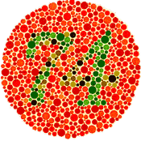
DETECTING COLORBLINDNESS
Color vision deficiency is usually detected using colored charts called the Ishihara Test Plates.
The plates consist of gray and colored dots.
The patient is asked to identify the number in the middle of the circle.
After the patient has identified what they see, more testing may commence.
Vision test examples. Normal people should see 74. Color deficient people may see D=21.

Slide 19
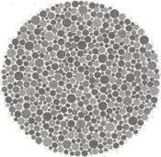
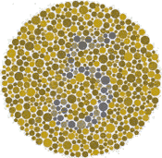
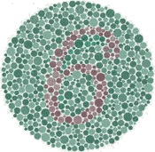
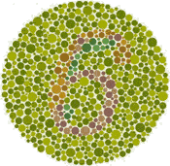
How are Tests Made?
A random pattern of gray level dots is first put together.
A digit pattern is then added which is defined by yellow/blue variation only. Since most people with red/green colorblindness can see yellow/blue they will be able to see the digit 5 in this test pattern.
Another digit pattern which is defined by red/green variation is added. Here is the pattern composed of the random brightness pattern and the red/green pattern.
Finally all three are added: People with red/green deficiency will not be able to see the red/green pattern and will see the 5. People with normal vision will see both the patterns, but since the red/green is stronger than the yellow/blue, the normal person will see the digit 6.

Slide 20
Photoreceptor Anatomy
Measuring Wavelengths:
Short wavelengths causes the green receptor to fire.
As the wavelength gets longer and closer to 580 nm the red begins to fire, surpassing the green.
Get mix of wavelengths.
Therefore, color vision is the consequence of unequal stimulation of the 3 types of cones. In a specific ratio.

Slide 21
PHOTORECEPTOR ANATOMY
Example: if you stimulate all 3 types of cones about equally the result is white or no color.

Slide 22
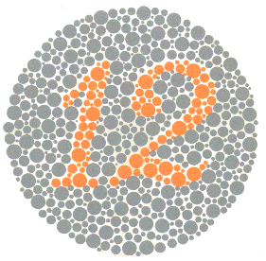
Plate 1 Both normal and those with all color vision deficiencies should read the number 12.

Slide 23
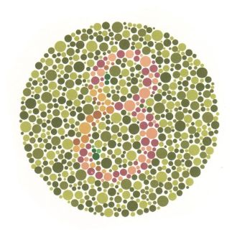
Plate 2
Those with normal color vision should read the number 8.
Those with red-green color vision deficiencies should read the number 3.
Total color blindness should not be able to read any numeral.

Slide 24
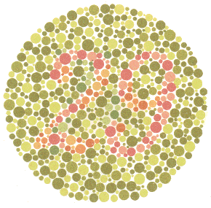
Plate 3 Normal vision should read the number 29. Red-green deficiencies should read the number 70. Total color blindness should not read any numeral

Slide 25
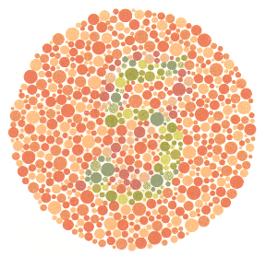
Plate 4 Normal color vision should read the number 5. Red-Green color deficiencies should read the number 2. Total color blindness should not be able to read any numeral.

Slide 26
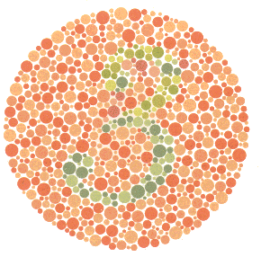
Plate 5 Normal color vision should read the number 3. Red-Green deficiencies should read the number 5. Total color blindness should not be able to read any numeral.

Slide 27
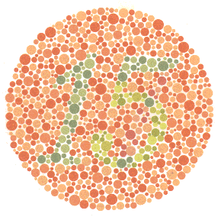
Plate 6 Normal color vision should read the number 15. Red-Green deficiencies should read the number 17. Total color blindness should not be able to read any numeral.

Slide 28
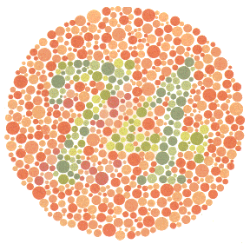
Plate 7 Normal color vision should read the number 74. Red-Green color deficiencies should read the number 21. Total color blindness should not be able to read any numeral.

Slide 29
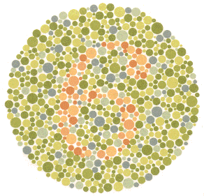
Plate 8 Normal color vision should read the number 6. The majority of those with color vision deficiencies cannot read this number or will read it incorrectly.

Slide 30
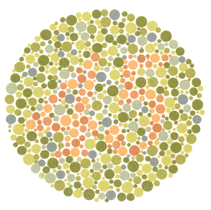
Plate 9 Normal color vision should read the number 45. The majority of those with color vision deficiencies cannot read this number or will read it incorrectly.

Slide 31
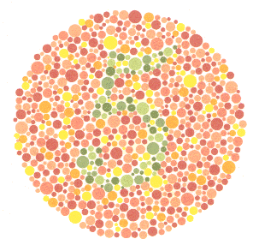
Plate 10 Normal color vision should read the number 5. Those with color vision deficiencies will not read the number or read it incorrectly.

Slide 32
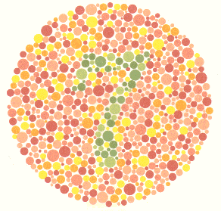
Plate 11 Normal color vision should read the number 7. Those with color vision deficiencies will not read this number or read it incorrectly.

Slide 33
Plate 12 Normal color vision should read the number 16. Those with color vision deficiencies will not read this number or read it incorrectly.

Slide 34
Plate 13 Normal color vision will read the number 73. Those with color vision deficiencies should nor be able to read this number or will read it incorrectly.

Slide 35
Plate 14 Normal color vision and those with total color blindness should not be able to read any number. The majority of those with red-green deficiencies should read the number 5.

Slide 36
Plate 15 Normal color vision and those with total color blindness should not be able to read any number. The majority of those with red-green deficiencies should read the number 45.

Slide 37
Plate 16 Normal color vision should read the number 26. In protanopia and strong protanomalia the number 6 is read and in mild protanomalia both numerals are read but the number 6 is clearer than the number 2. In deuteranopia and strong deuteranomalia only the number 2 is read and in mild deuteranomalia both the number 2 is clearer than the number 6.

Slide 38
Plate 17 Normal color vision should read the number 42. In protanopia and strong protanomalia the number 2 is read and in mild protanomalia both numerals are read but the number 2 is clearer than the number 4. In deuteranopia and strong deuteranomalia only the number 4 is read and in mild deuteranomalia both the number 4 is clearer tha the number 2.

Slide 39
Plate 18 The normal should trace along the purple and red lines between the two X’s. In protanopia and strong protanomalia only the purple line is traced and in mild protanomalia both lines can be traced but the purple line is easier to follow. In deuteranopia and strong deuteranomalia only the red line is traced and in mild deuteranomalia both lines are traced but the red line is easier to follow.

Slide 40
Plate 19 The majority of those with red-green color blindness can trace the winding line between the two X’s. The majority of those with normal and total color blindness are unable to follow the line.

Slide 41
Plate 20 Normal will trace the blue-green line between the two X’s. The majority of those with color vision deficiencies will be unable to follow the line or will follow a line different to the normal one.

Slide 42
Plate 21 Normal will trace the orange line between the two X’s. The majority of those with color vision deficiencies will be unable to follow the line or will follow a line different to the normal one.

Slide 43
Plate 22 Normal should trace the line connecting the blue-green and the yellow-green. Those with red-green deficiencies trace the line connecting the blue-green and purple. Those with total color blindness cannot trace any line.

Slide 44
Plate 23 Normal should trace the line connecting the purple and the orange between the two X’s. Red-green deficiencies should trace the line connecting the purple and the blue-green. Total color blindness and weakness cannot trace any line.

Slide 45
Plate 24 Both normal and those with color vision deficiencies can trace the winding line between the two X's.

